Slide 1
ASP .NET Web API 2
26 Mar 18 | Start
10 May 18 | 1: 3-19
11 May 18 | 4: 86-90
Appendix
Online

Slide 2
Web API 2
Ch | Date
1 | 10 May 18
2
3
4
5
6
7
8
9
10
11
12
13
Expert ASP.NET Web API 2 for MVC Developers 2014

Slide 3
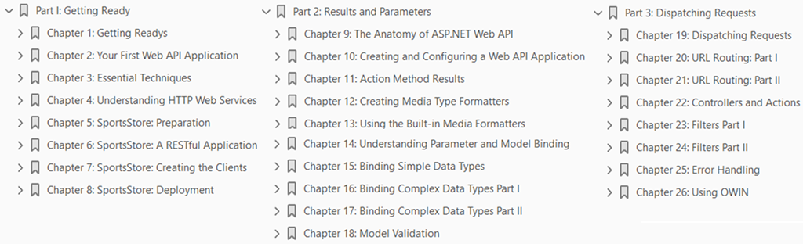

Slide 4
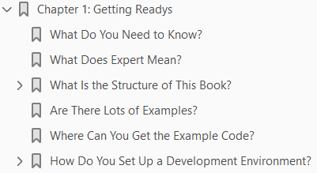
1
Getting Ready

Slide 5
Intro
Web API 2 is the latest evolution of Microsoft’s web services toolkit, which allows you to create RESTful applications built on the ASP.NET platform.
It provides a standards-based approach and a high-productivity development model that makes it easy to deliver services to a wide range of clients, including mobile devices.
In this book, I take you right from creating your first Web API web services to the most advanced techniques and features.
No prior knowledge of HTTP web services or Web API is required.
I start with the basics and explain everything you need to know.
In short, this book will give you expert insight and understanding of how to create, customize, and deploy complex, flexible, and robust HTTP web services.
Web services don’t exist in isolation, as such we will write browser-based single-page applications to consume them.
I demonstrate how these clients influence the way that Web API web services respond and how you can adapt your web service to different client types.

Slide 6
What Do You Need to Know?
You should be familiar with using the ASP.NET MVC framework to create web applications.
This means you are able to use Visual Studio to write C# classes and know how to use Razor and HTML to create views.
The term Expert in the title refers to the degree of depth that I cover in this book, and you don’t need any knowledge of Web API or HTTP web services;
however, if you don’t know how to use ASP.NET MVC, then you will struggle to follow many of the examples.
If you want to brush up on your knowledge of MVC, then read my Pro ASP.NET MVC 5 and Pro ASP.NET MVC Platform books, both published by Apress.

Slide 7
What Does Expert Mean?
This book is for programmers who want to understand every aspect of web services development using ASP.NET Web API.
Or, put another way, you want to be an expert in Web API.
I dig deeply into the details of how Web API works behind the scenes in this book and give you a warts-and-all view of how Web API can be used to create sophisticated and secure RESTful web services.
You don’t have to know anything about Web API or HTTP web services before you start.
I build on your existing knowledge of the MVC framework to give you all the information you need.

Slide 8
What Is the Structure of This Book?
This book is split into three parts, each of which covers a set of related topics.
Part 1: Getting Ready
Part 2: Results and Parameters
Part 3: Dispatching Requests

Slide 9
Part 1: Getting Ready
Part 1 of this book provides the information you need to get ready for the rest of the book.
It includes this chapter and a primer for the techniques you will need to follow the examples in this chapter.
I also show you how to build your first web service and single-page client and take you through the process of building a more realistic application, called SportsStore.

Slide 10
Part 2: Results and Parameters
Part 2 of this book focuses on the aspect of Web API that you will spend most of your time on during your first real projects:
the data sent from clients and the responses that you produce in return
I explain how to
create different kinds of HTTP responses using Web API
how to master the data binding process that Web API uses to process request data
how to ensure that the data you receive from clients is valid

Slide 11
Part 3: Dispatching Requests
Part 3 of this book explains how Web API dispatches HTTP requests from the moment they arrive from the client until the response is generated.
I describe all of the steps that a request goes through and show you how to configure and customize just about every class and interface that Web API relies on to get fine-grain control over how your web services operate.
I show you
how Web API uses the URL routing system to support RESTful web services
how controllers and action methods are selected
how to deal with errors and cross-cutting concerns
Many of these techniques are similar to the ones you know from MVC framework development, but Web API uses its own namespaces and classes and has a different approach than the one you are used to using.

Slide 12
Are There Lots of Examples?
There are loads of examples.
The best way to learn Web API is by example, and I have packed as many of them as I can into this book.
To maximize the number of examples in this book, I have adopted a simple convention to avoid listing the contents of files over and over again.
The first time I use a file in a chapter, I’ll list the complete contents, just as I have in Listing 1-1.
For the second and subsequent examples, I show you just the elements that change, in a partial listing.
You can spot a partial the listing because it starts and ends with ellipsis (...), as shown in Listing 1-2.

Slide 13
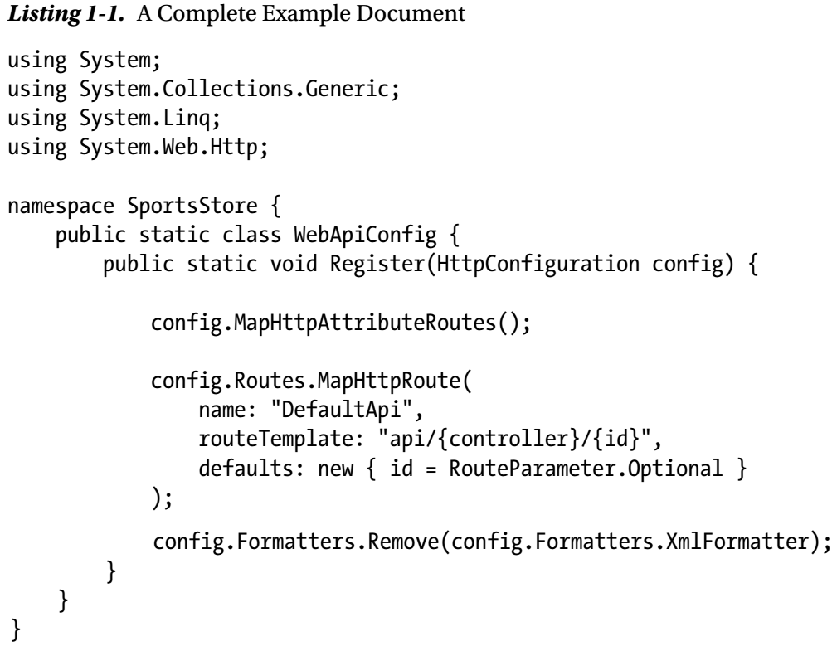
Listing 1-1

Slide 14
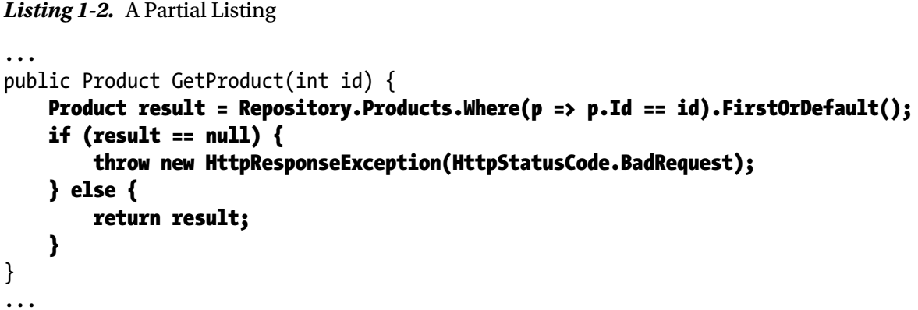
Listing 1-2

Slide 15
Where Can You Get the Example Code?
You can download all of the examples for all of the chapters in this book from www.apress.com.
The download is available without charge and includes all of the supporting resources that are required to re-create the examples without having to type them in.
You don’t have to download the code, but it is the easiest way of experimenting with the examples and cutting and pasting them into your own projects.
If you do want to re-create the examples from scratch, then you will find that every chapter contains detailed listings of all the files I create and modify.
I never refer you to an external file or hand-wave about leaving the rest of the example as an exercise; every detail you need to re-create every example is contained within this book.

Slide 16
How Do You Set Up a Development Environment?
The most important software you need for this book is Visual Studio 2013, which contains everything you need to get started, including
a built-in application server for running and debugging Web API applications
an administration-free edition of SQL Server for developing database-driven applications
a code editor compiler and debugger

Slide 17
Getting Visual Studio
There are several editions of Visual Studio, but I will be using the one that Microsoft makes available free of charge, called Visual Studio Express 2013 for Web.
Microsoft adds some nice features to the paid-for editions of Visual Studio, but you will not need them for this book, and all of the figures that you see throughout this book have been taken using the Express edition, which you can download from www.visualstudio.com.
There are several versions of Visual Studio 2013 Express, each of which is used for a different kind of development.
Make sure you get the Web version, which supports ASP.NET applications.
I follow a specific approach to creating ASP.NET projects: I don’t use the predefined templates that Microsoft provides, preferring to explicitly add all of the packages I require.
This means more work is required to get set up, but the benefit is that you end up with a much better understanding of how an application fits together.
I provide a primer in Chapter 2 that gives an example of what you can expect.

Slide 18
Preparing Visual Studio
Visual Studio Express contains all the features you need to create, test, and deploy Web API applications, but some of those features are hidden away until you ask for them.
To enable all of the features, select Expert Settings from the Visual Studio Tools ➤ Settings menu.
Microsoft has decided that the top-level menus in Visual Studio should be all in uppercase, which means that the menu to which I just referred is really TOOLS.
I think this is rather like shouting, and I will capitalize menu names like Tools is here throughout this book.

Slide 19
Getting Google Chrome
In this book, I use the Google Chrome browser.
In part this is because it has some excellent F12 developer tools (so-called because they are accessed by pressing the F12 key) but also because using Chrome allows me to use Postman, an outstanding HTTP client that makes it easy to test web services by manually crafting HTTP requests.
You can download Chrome from https://www.google.com/chrome/browser and, once it is installed, get the Postman client from www.getpostman.com.
Both are available without charge, but I encourage you to donate to the Postman developers if you find it useful.
You will also need the Postman Interceptor extension, which increases the functionality and is available through the Google Chrome Extension Store as a zero-cost installation.
Click the Chrome settings button (the one with three horizontal lines at the right side of the screen) and select Tools ➤ Extensions.
Search for Postman Interceptor and follow the installation instructions.

Slide 20
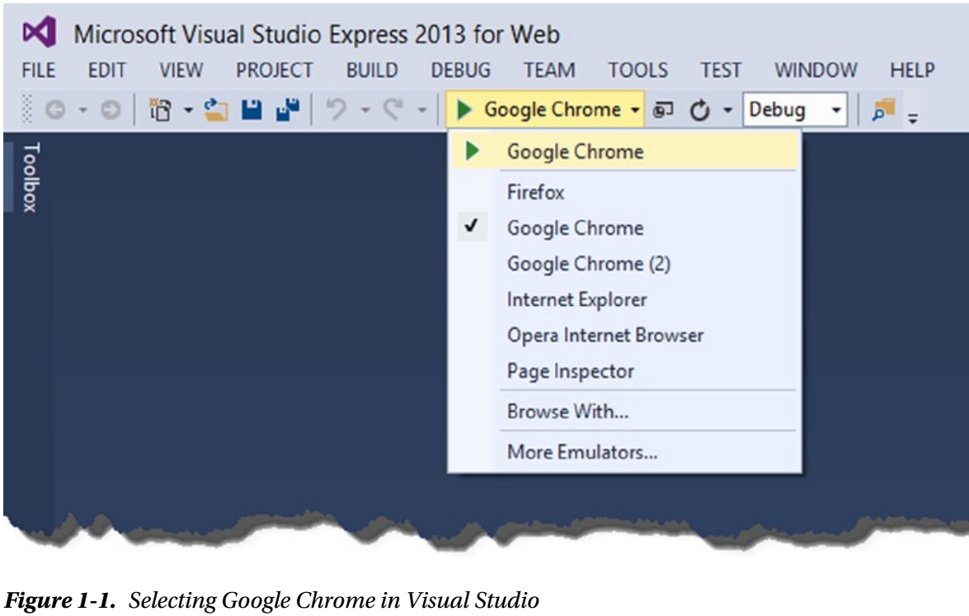
Selecting Chrome for Debugging
You can select Chrome as the browser that Visual Studio will start when you debug a project by selecting it from the drop-down list of browsers, as shown in Figure 1-1.

Slide 21
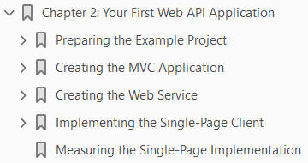
2
Your First Web API Application

Slide 22
Intro
The best way to get a feel for a new technology is by applying it, so in this chapter I jump right in and demonstrate one of the most common uses for Web API: adding an HTTP web service to an existing MVC framework application.
This is nowhere near as awkward as it might sound, not least because the MVC framework and Web API share a common heritage and can use the same data models.
In fact, you may be surprised at how little time I spend in this chapter creating the web service compared with building the example MVC framework application and writing the JavaScript code that consumes the web service in the browser.
You don’t need to retrofit an HTTP web service to an existing application, of course, and in Chapters 5–8 I build a more complex example that begins with Web API and puts the HTTP web service right at the heart of the development process.

Slide 23
Preparing the Example Project
Visual Studio includes templates for different kinds of projects.
The basic starting point is the Empty project, which can be set up to include just the files and references required for an MVC or Web API application.
Other options add models, views, and controllers to help kick-start a project by providing commonly used features.
I prefer to work with the Empty template and just have Visual Studio add the minimum initial content—and I recommend you do the same.
This approach gives you greater insight into how an application is put together and where you need to start looking when something goes wrong.
Throughout this book, I’ll be creating projects in the way that I describe here, so I’ll walk through the process step-by-step in this chapter so you know what to expect.

Slide 24
Creating the Visual Studio Project
To get started, I created a new Visual Studio project. Select New Project from the File menu to open the New Project dialog window.
Navigate through the Templates section to select the Visual C# ➤ Web ➤ ASP.NET Web Application template and set the name of the project to PartyInvites, as shown in Figure 2-1.
Click the OK button to move to the New ASP.NET Project dialog window.
Ensure that the Empty option is selected and check the MVC and Web API options, as shown in Figure 2-2.
Click the OK button, and Visual Studio will create a new project called PartyInvites.

Slide 25
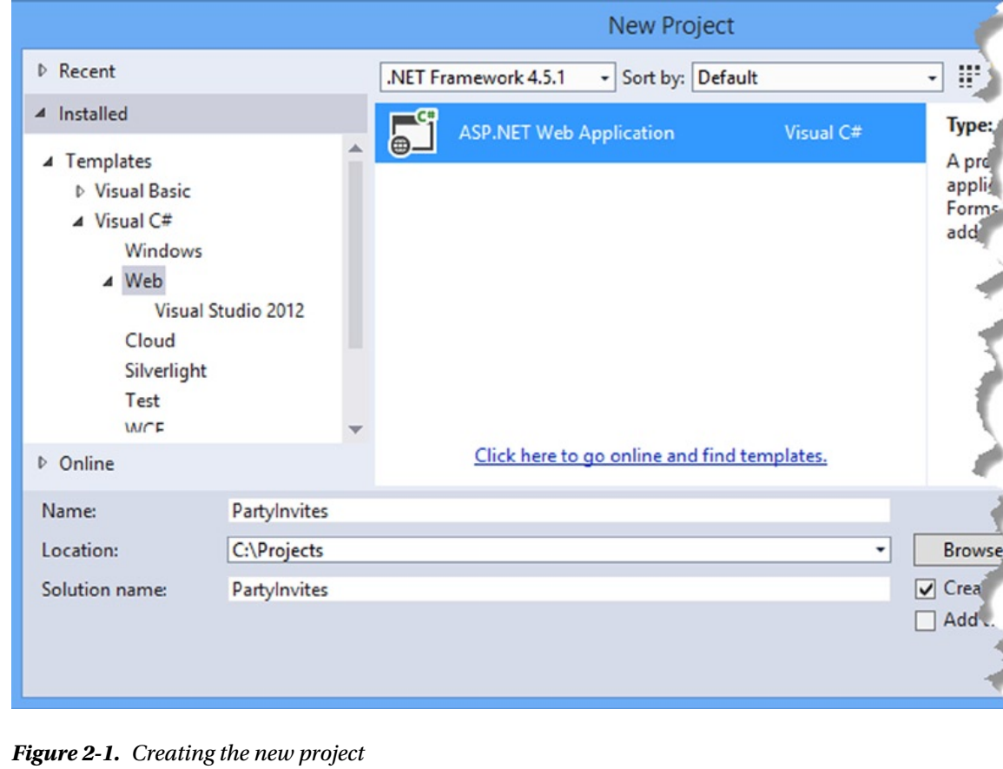
Figure 2-1

Slide 26
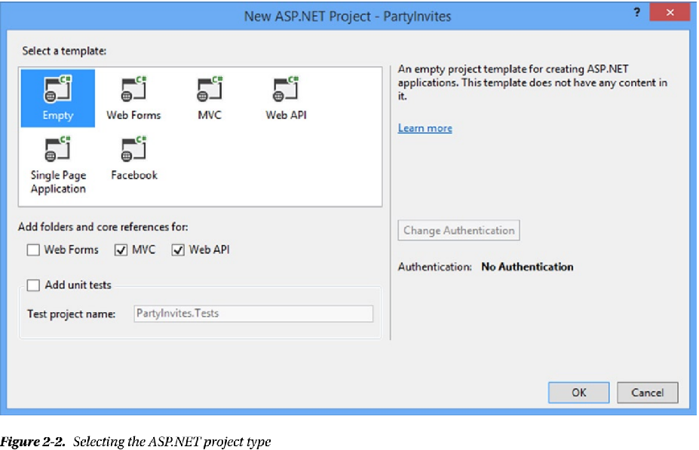
Figure 2-2

Slide 27
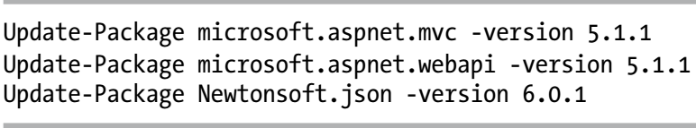
Adding and Updating NuGet Packages
One of the most useful enhancements to Visual Studio in recent years has been the addition of NuGet, which makes it easy to download, install, and update software packages in a project.
I am going to be working with specific versions of NuGet packages in this book to make sure you are able to re-create the examples and get the same results.
The days where Microsoft made enormous releases of the entire .NET stack every 18 months have passed, and each piece of technology receives more frequent small updates.
This means the versions of the MVC and Web API that are added to projects by Visual Studio may not be the latest versions available.
Select Package Manager Console from the Visual Studio Tools ➤ NuGet Package Manager menu and enter the following commands to update the MVC and Web API packages, as well as the package that is used to process JSON data (I describe JSON in more detail in Chapter 3):

Slide 28
Other Packages
There are two other packages that I rely on for the example application in this chapter and those in later chapters.
The first is Bootstrap, which is a CSS package that makes it easy to style the HTML generated by MVC views.
I have no visual design skills at all—to the extent that I was excused from art lessons at school and allowed to do extra math— but even I can hack together something that looks appealing with Bootstrap.
I prefer to work with a real designer on complex projects, but for simple applications, Bootstrap works just fine.
The second package I use is jQuery, which provides an abstraction layer that simplifies working with the HTML Document Object Model API and makes Ajax requests simpler and more elegant.
jQuery is the de facto JavaScript library for developing the client-side part of web applications and—just like Bootstrap—has recently been adopted by Microsoft in the Visual Studio project templates.
I provide a primer for using jQuery to make Ajax requests in Chapter 3.
The final package I use is Knockout, which makes it easy to build an HTML client that responds dynamically to the data returned by a web service or by interactions with the user. I give a brief introduction to using Knockout in Chapter 3.
To add Bootstrap, jQuery, and Knockout to the project, enter the following commands shown in Figure 2-21 into the Package Manager Console:

Slide 29
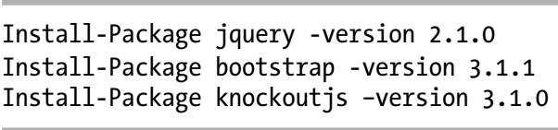
Figure 2-21

Slide 30
Setting the Port and Start URL
The final preparations I need to make specify the TCP port that will be used to receive requests and the initial URL that will be passed to the browser when the project is started.
Select Party Invites Properties from the Visual Studio Project menu and click Web to open the settings for ASP.NET projects.
Enable the Specific Page option and enter Home/Index in the field.
On the same page, change the value in the Project Url field to http://localhost:37993/ and click the Create Virtual Directory button.
The first change prevents Visual Studio from trying to work out what URL should be shown when the application starts based on the file you edited most recently, and the second change means that requests will be received on TCP port 37993.

Slide 31
Creating the MVC Application
In this section, I create a simple MVC framework application that gathers responses from invitees to a party.
This is a variation on the project with which I start the Pro ASP.NET MVC 5 book, and I chose it to emphasize the ease with which Web API can be applied to MVC framework applications.
I spend much of the rest of the book explaining the differences, so it is good to start with something that focuses on just how much you already know how to do.

Slide 32
Creating the Model
Now that I have created the project, I can add the model.
The structure of a Web API application shares a lot with the MVC framework, which is one of the reasons that both technologies can coexist so well.
I created a file called GuestResponse.cs in the Models folder and used it to define the class shown in Listing 2-1.
To create a simple model repository, I created a class file called Repository.cs in the Models folder and used it to define the class shown in Listing 2-2.
The repository for this application is simple and stores its data objects as a collection in memory that is exposed through static properties.
This means the model state will be lost when the application is restarted, but it does allow me to keep the example simple. (I show a more persistent model in Chapter 5 when I create a larger and more realistic MVC/Web API application that stores its model in a database.)
In the static constructor, I add some default data so that the model is populated with responses.

Slide 33
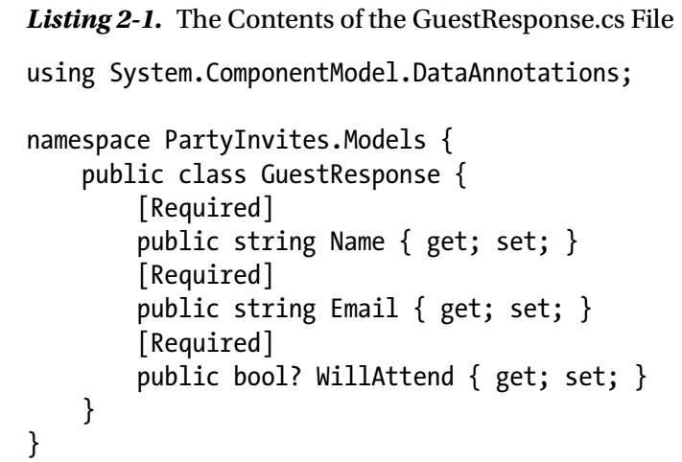
Listing 2-1

Slide 34
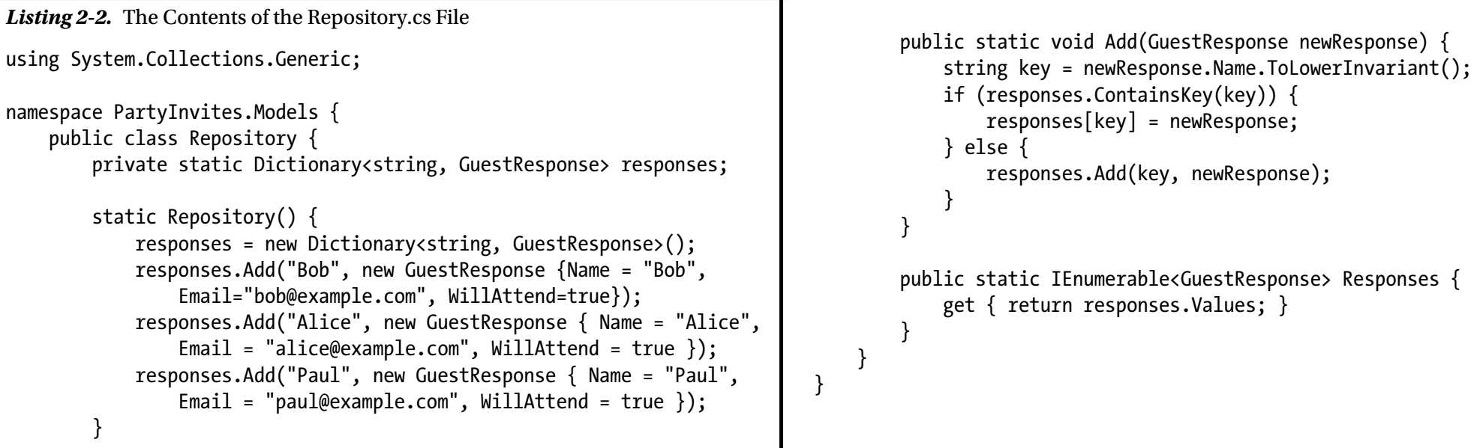
Listing 2-2

Slide 35
Creating the MVC Controller
My next step is to create an MVC controller that will generate content and receive form data from my application clients. Web API also has controllers—as you will see in the “Creating the Web Service” section—and I will be clear about which kind of controller I am using throughout this book.
I created an MVC controller by right-clicking the Controllers folder and selecting Add ➤ Controller from the pop-up menu.
Figure 2-3 shows the options that Visual Studio presents for creating controllers for both MVC and Web API.
Visual Studio is able to generate a templated set of action methods for controllers, but I will be using empty controllers for both MVC and Web API throughout this book.
Just as with the project template, I prefer to define just the code I need for my applications, and I follow the same approach for the examples in this book so that you know where every action methods comes from and why I have added it.
I selected the MVC 5 Controller – Empty option from the list, clicked the Add button, and set the name to HomeController, as shown in Figure 2-4.
Clicking the Add button creates the Controllers/HomeController.cs file, which I used to define the controller shown in Listing 2-3.

Slide 36
Creating the MVC Controller |
The controller defines four action methods.
The Index action simply renders a view that welcomes the user to the application.
The Rsvp methods allow the user to populate the fields of a GuestResponse model object through model binding and validate using the model state feature.
When the user submits a complete set of values for the GuestResponse object (enforced by the use of the Required attribute in Listing 2-1), I update the repository and render a view called Thanks.
The final action method can be called only as a child action, and it returns the collection of GuestResponse objects that represent users who have indicated they will attend.
This is a pretty basic controller, but it captures the core characteristics of most MVC framework applications, albeit on a simplified basis.
Operations are performed on the repository, form data values are bound to object properties using model binding, and action methods are set up to be invoked based on the HTTP verb used in the request.

Slide 37
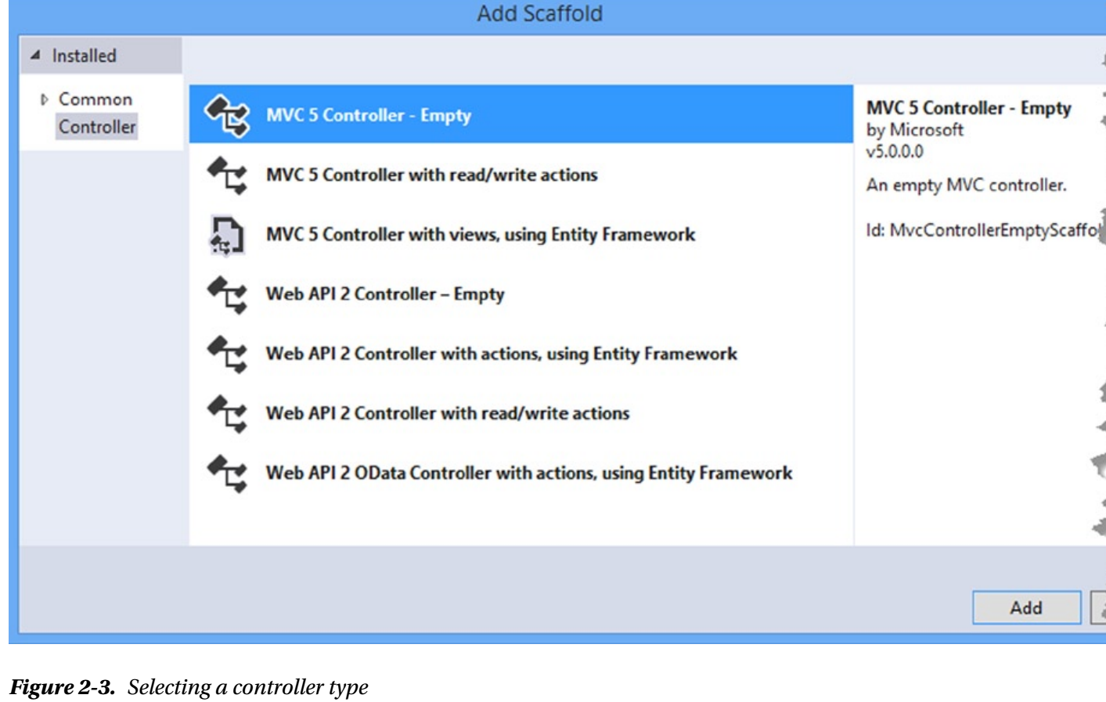
Figure 2-3

Slide 38
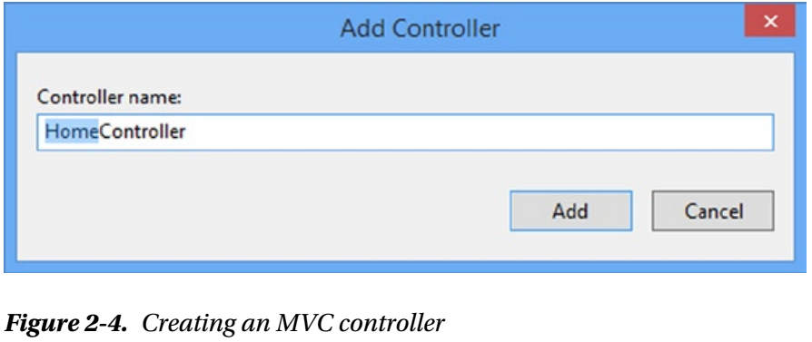
Figure 2-4

Slide 39
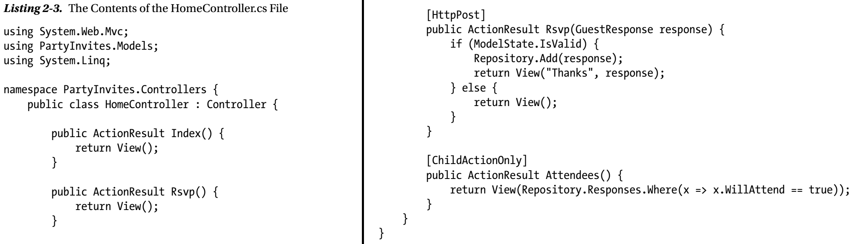
Listing 2-3

Slide 40
Creating the Views
I need to create a layout and four views for my example application.
I created the Views/Shared folder, and Listing 2-4 shows the _Layout.cshtml file I added to it, which contains references for the Bootstrap, jQuery, and Knockout files.
Listing 2-5 shows the Index.cshtml file that I created by right-clicking the Index action method in the Home controller and selecting Add View from the pop-up menu.
I set View Name to Index, ensured that the Use a Layout Page option is checked, and clicked the Add button to create the view file. (Visual Studio also creates the Views/_ViewStart.cshtml file, which ensures that the _Layout.cshtml file I created in Listing 2-4 is applied.)
This view doesn’t contain any model data, but it does use the routing system to generate a link element that targets the Rsvp action method on the same controller.
Listing 2-6 shows the view that the Rsvp action renders, which is the Rsvp.cshtml file I added to the /Views/Home folder.
This view contains a standard HTML form that collects values from the user via input and select elements. When the user submits the form with valid data, the Thanks.cshtml view in the Views/Home folder is rendered.
You can see the contents of the Thanks.cshtml file in Listing 2-7.

Slide 41
Creating the Views |
If the user has indicated that they will attend the party, then I use the Html.Action helper to invoke the Attendees child action method, which renders the /Views/Home/Attendees.cshtml view file, whose contents are shown in Listing 2-8.

Slide 42
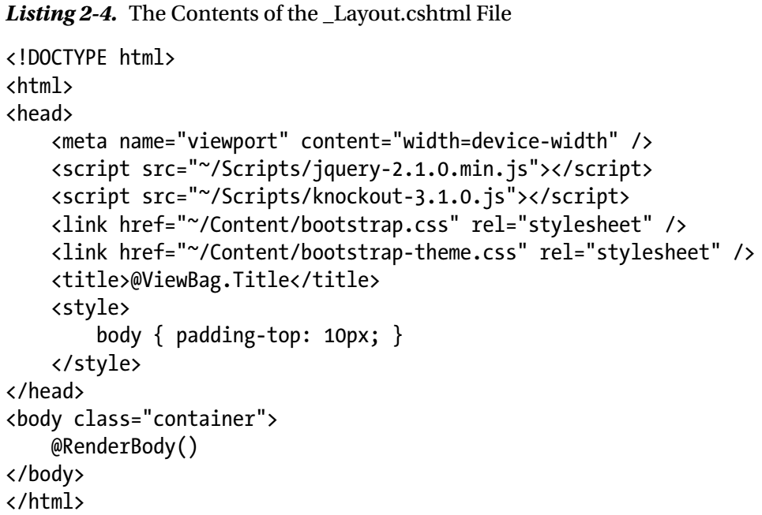
Listing 2-4

Slide 43
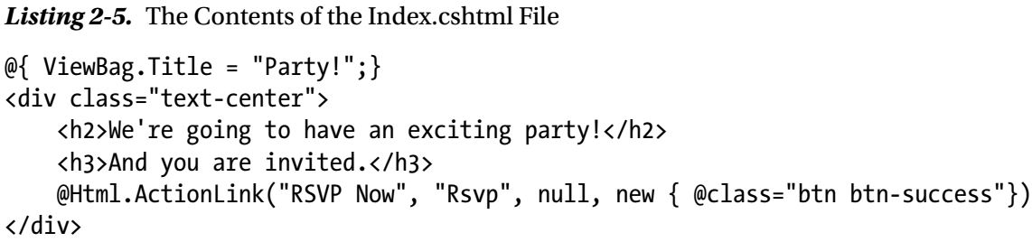
Listing 2-5

Slide 44
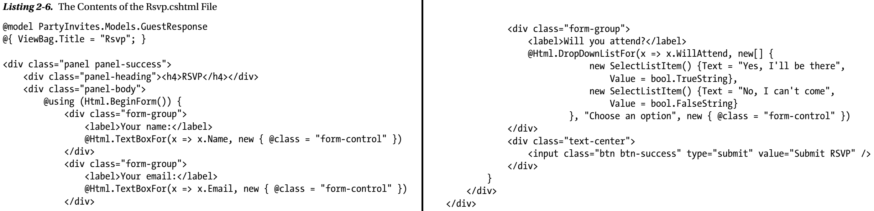
Listing 2-6

Slide 45
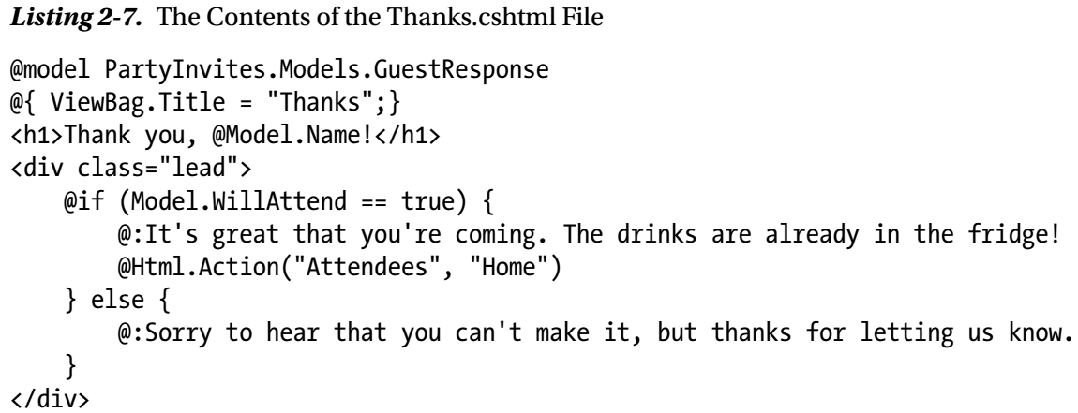
Listing 2-7

Slide 46
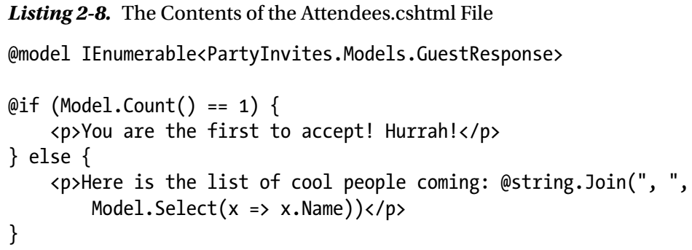
Listing 2-8

Slide 47
Using the MVC Application
To test the basic functionality, start the application and navigate to the /Home/Index URL.
Click the RSVP Now button, fill out the form, and click Submit RSVP.
Figure 2-5 shows the different views rendered by the application.
If you get an error telling you that the Attendees action is accessible only as a child request, it is because Visual Studio has tried to be helpful and has told the browser to navigate to the /Home/Attendees URL because that is the last view you were editing.
Navigate to /Home/Index, and everything will be fine.

Slide 48
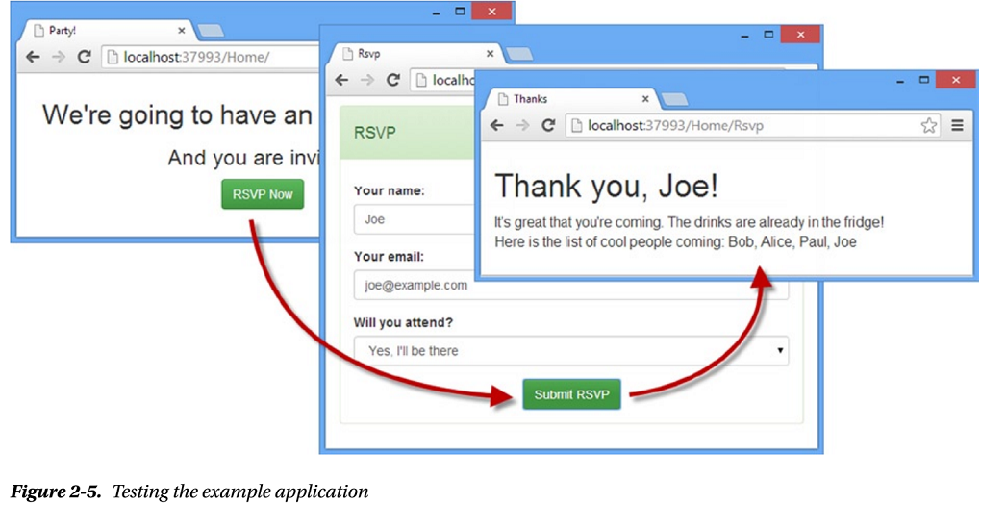
Figure 2-5

Slide 49
Developer Tools - F12 Tools
Google Chrome, like all modern browsers, contains some useful developer tools, known as the F12 tools because they are opened by pressing F12 on the keyboard.
Before adding Web API to the application, I am going to use the F12 tools to
measure the number of requests and
the total amount of data sent from the server
Getting an honest assessment of the requests required to go through the RSVP process entails some specific steps, switching between the browser window that displays the applications and the F12 tools.
Here is the sequence:
Open the F12 tools, click the Network tab and check the Preserve Log option so that the list of network requests isn’t cleared for each new request.
Ensure that the first icon in the toolbar, which is a circle, is red, indicating that Chrome will record the network requests it makes. If the circle isn’t red, then click it so that it is.
Ensure that the browser window is showing the /Home/Index URL.
Click the Clear button on the F12 toolbar (it is next to the red circle button).
Right-click the Reload icon in the browser window and select Empty Cache and Hard Reload from the pop-up menu, as shown in Figure 2-6.

Slide 50
Developer Tools - F12 Tools |
Click the RSVP Now button in the browser window, complete the form, and click the Submit RSVP button to send the form data to the server.
The menu shown in Figure 2-6 is available only when the F12 tools window is open.
The F12 Network tab will detail requests that the browser makes as you work through the example application.
Not all of these are for action methods—I added link and script elements to the _Layout.cshtml file, which is used as the layout for all the views and so the Bootstrap and JavaScript files have to be loaded from the server. (This happens just for the initial request so that the files are in the browser cache. You can see which requests are cached by the browser by looking at the Size column.)
At the bottom of the F12 window, Chrome displays a summary of the requests it has made, and I have put my results in Table 2-1.
Don’t worry if you get different numbers; I just want to give an illustrative reference.

Slide 51
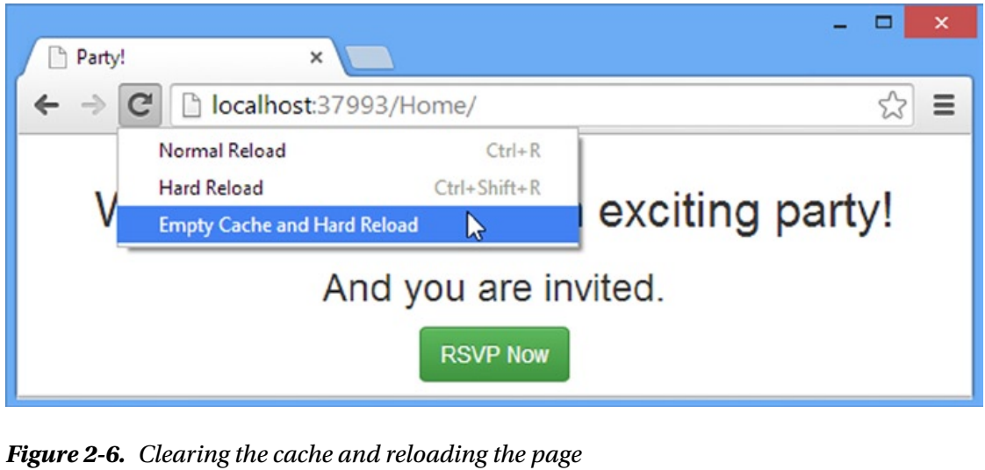
Figure 2-6

Slide 52
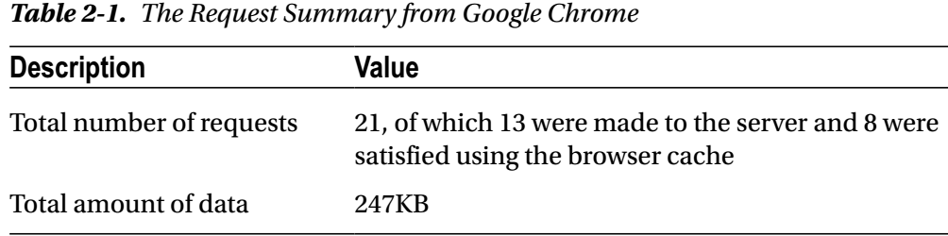
Table 2-1

Slide 53
Creating the Web Service
Now that I have a basic MVC framework application in place, I can add some Web API functionality to create a web service that exposes my RSVP model to HTTP clients.
In the sections that follow, you will see just how easy it is to use MVC and Web API side-by-side.
Adding an HTTP web service to an existing MVC framework isn’t the only way to use Web API, but it is the one I have started with in this book because it is such a common task.
It also lets me demonstrate how much commonality there is between MVC and Web API and how that commonality can be leveraged for quick results.
In Chapter 6, I show you a more considered approach to using Web API when I start by designing the web service first.

Slide 54
Creating the Web API Controller
Just like MVC, Web API uses controllers that define action methods that handle HTTP requests.
I created a Web API controller by right-clicking the Controllers folder, selecting Add ➤ Controller from the pop-up menu, and selecting Web API 2 Controller – Empty from the list of controller types, as shown in Figure 2-7.
Just as with MVC controllers, Visual Studio can create controllers with templated content.
I’ll be using the empty controller for Web API throughout this book so that I can explain the purpose of all the code statements I use.
Click the Add button once you have selected the type, set the name of the new controller to RsvpController, and click the Add button to create the Controllers/RsvpController.cs file.
Listing 2-9 shows the action methods that I added to the RsvpController class to create a simple web service.
The first thing to notice about my controller is that the base class is ApiController, which is defined in the System.Web.Http namespace.
This is a different base class and namespace than an MVC controller uses because Web API doesn’t use the standard System.Web and System.Web.Mvc namespaces.
Instead, Web API uses separate classes, even for functionality that is shared with MVC, such as filter attributes.

Slide 55
Creating the Web API Controller |
Hover the mouse over the HttpGet or HttpPost attributes in the code editor, and the pop-up box will tell you that these are classes defined in the System.Web.Http namespace, not the System.Web.Mvc namespace that defines the attribute I applied to the Home MVC controller.
Next, notice that the result from the GetAttendees action method is an enumeration of my GuestResponse model class.
Web services deliver data to their clients and don’t use views to generate HTML content, so there is no need for the ActionResult objects you are familiar with from MVC applications.
This makes Web API controllers more like regular C# classes, although there are lots of options available for taking control over how the data returned from a Web API action method is formatted and sent to the client, which I explain in Part 2 of this book.

Slide 56
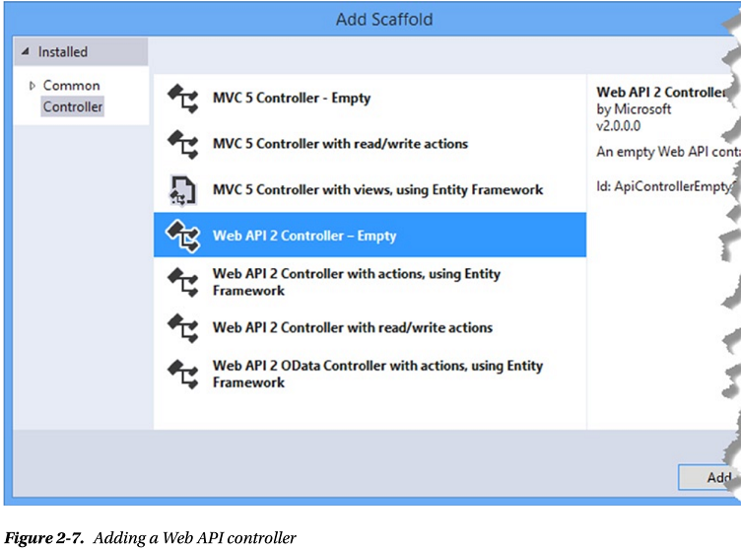
Figure 2-7

Slide 57
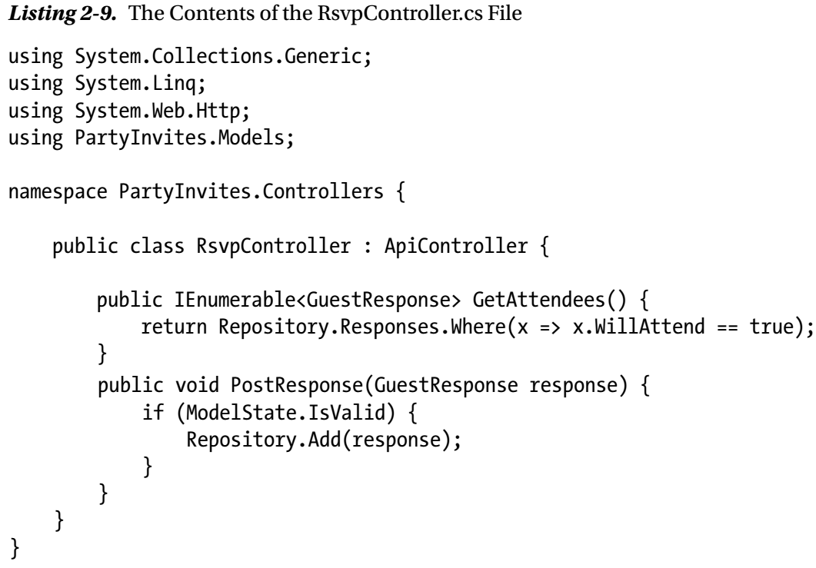
Listing 2-9

Slide 58
Note
The fact that MVC and Web API have distinct versions of classes with the same names that perform the same function is confusing and is the most common cause of errors for developers new to Web API.
Be careful that you don’t add the System.Web.Mvc namespace to Web API controllers.

Slide 59
IS THAT IT?
The RsvpController class is the only one I need to add to the project to create an HTTP web service.
The rest of this chapter is given over to checking that the web service works and implementing the client-side jQuery code that consumes the service.
You might be asking yourself, is that it? The answer is yes and no.
Yes, because you can create a basic HTTP web service just by adding a Web API controller to the project.
In this example, I was able to minimize the amount of work I had to do by reusing the model that I created for the MVC framework application and relying on the default conventions and configuration of a Web API application.
And no, that isn’t it because this is a trivially simple example that I designed specifically to emphasize how easy it is to get started with Web API.
Creating sophisticated and robust HTTP web services requires more knowledge about how Web API works and how to consume web services in the browser.
Happily, I explain everything you need to know in the rest of this book, starting with the SportsStore application in Chapter 5, where I define an equally simple Web API controller and show its transformation as I enable more features.

Slide 60
Testing the Web API Controller
As simple as the RsvpController is, it is all that I need to add a basic HTTP web service to my application.
I am relying on some convention and default configuration settings, of course—which I’ll explain in depth in Part 2, but with the addition of one simple class I have a web service that is capable of delivering data over HTTP.
There are different levels of testing that you can perform on a web service created with Web API.
There is unit testing, which can be applied in much the same way as for MVC framework application.
And, of course, you can perform system-level testing once the web service is integrated into the client.
For this chapter, I am going to use the Postman tool that I described and installed in Chapter 1.
To recap, Postman is a Chrome application that provides excellent support for testing web services, even the basic kind that I have created here.
It is free to use, although donations are accepted, and it makes it easy to explore a web service without having to write any code at all.

Slide 61
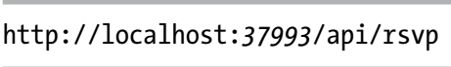
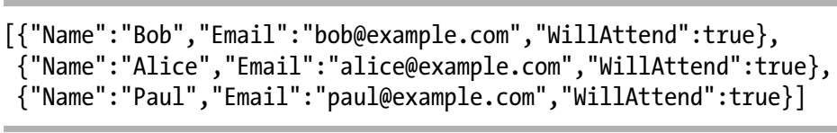
Postman
Start the application and then start Postman by opening a new Chrome tab, clicking the Apps icon in the top-left corner of the toolbar, and clicking the Postman icon.
Postman will open a new window. Replace the “Enter request URL here” text with, the following URL:
Once you have entered the URL, click the Send button, and Postman will send a request to the web service and display the data that it gets, as shown in Figure 2-8.
The URL I specified targeted the GetAttendees action method on the Web API Rsvp controller, and the data that is returned represents the responses from potential guests.
It can be hard to make out from the figure, but here is the data that Postman receives from the web service:

Slide 62
Postman |
This is the JSON data format, which is especially easy to work with in JavaScript—as you’ll see when I implement the client-side part of the application in the “Implementing the Client” section.
I describe JSON in a little more detail in Chapter 3, but the initial [ and final ] characters indicate an array of objects—just like in C# each set of braces (the { and } characters) denotes a single object.
Each object in this array has Name, Email, and WillAttend properties, and the values correspond to the initial model data that I defined in the Repository class in Listing 2-2.
Postman can also be used to test HTTP POST requests, which allows me to test my PostResponse action method as well, although care must be taken to configure the request correctly.
To target the PostResponse action method, change the HTTP verb for the request to POST by clicking the button marked GET to the right of the URL and selecting POST from the drop-down list.
Now click the x-www-form-urlencoded button to select the format in which Web API expects to receive form data and enter key/value pairs to define the properties in Table 2-2.
Figure 2-9 shows the section of the Postman interface that displays the required settings.

Slide 63
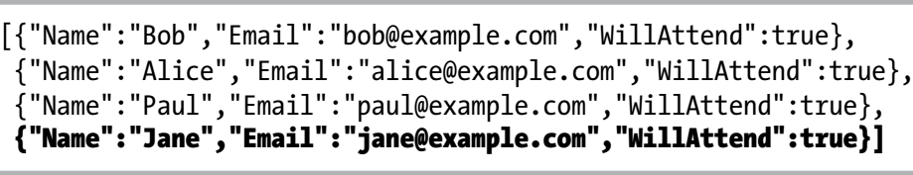
Postman ||
Click the Send button to send the POST request to the application.
The PostResponse action method doesn’t return any data, so the response area of the Postman interface doesn’t show any data, but if you send a GET request to the GetAttendees method (which you can easily do from the Postman History area), you will see that a new RSVP object is included in the JSON data, like this:

Slide 64
Note
Web API uses the ASP.NET routing system to match requests to controllers and action methods, which means that URLs can be customized.
The default convention is that all URLs for Web API web services are prefixed with /api, followed by the controller name.
The selection of the action method is made using the HTTP verb from the request, matched to an action method whose name begins with the verb—so the GET request sent by Postman to /api/rsvp is mapped to the GetAttendees action method in the RsvpController class.
I explain more about how this mapping works in Chapter 22.
The Web API automatically converted the result from the GetAttendees action method from IEnumerable<GuestResponse> to a JSON array.
I explain how this happens—and show you how to control the conversion process—in Part 2.

Slide 65
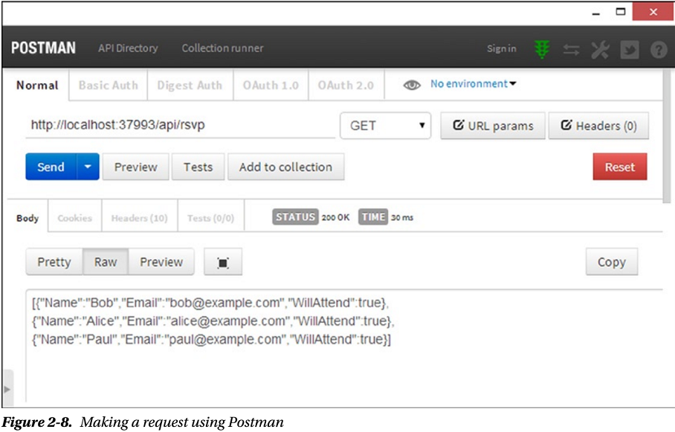
Figure 2-8

Slide 66
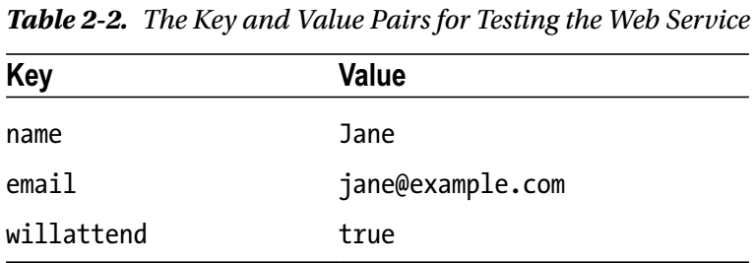
Table 2-2

Slide 67
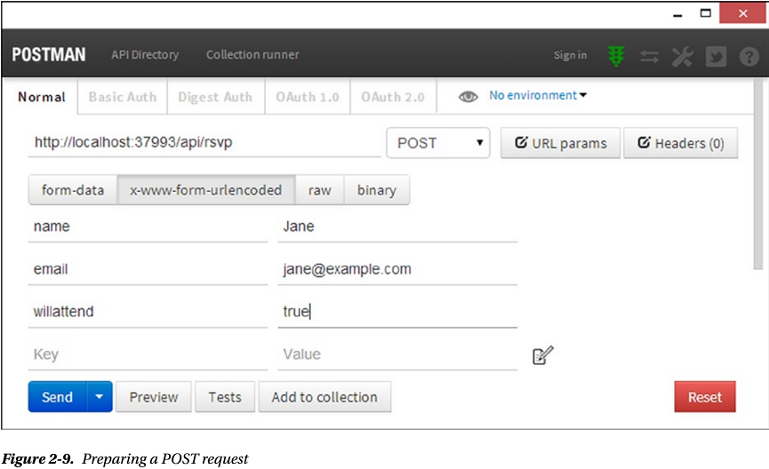
Figure 2-9

Slide 68
Implementing the Single-Page Client
Using Postman allows a web service to be tested by manually composing requests.
It is a nice way to test the web service separately from the MVC framework part of the application, but that isn’t good for users, who generally don’t want to type URLs and read JSON strings.
In this section, I will update the MVC part of the application to use jQuery to consume the HTTP web service I created using Web API.
My goal is to create a simple single-page application, where a single HTML document is requested by the browser and then manipulated and populated using JavaScript and data obtained via Ajax requests.
For this example, I am also going to ensure that non-JavaScript clients can still use the application.
JavaScript is remarkably prevalent these days, but there are still devices that don’t support it and a substantial minority of users who disable JavaScript in their browsers, mostly for reasons of security.

Slide 69
Setting Up JavaScript IntelliSense
Visual Studio is capable of providing the same kind of IntelliSense editor support for JavaScript like it does for C#.
This makes working with libraries such as jQuery quicker and less error-prone, especially since JavaScript code doesn’t go through a compiler in the same that that C# does—any errors in the code are not revealed until runtime.
To enable JavaScript IntelliSense, add a new JavaScript file called _references.js (don’t forget the leading underscore character) in the Scripts folder.
Listing 2-10 shows the additions I made to the new file to set up IntelliSense for the jQuery file present in the project.
A reference element has a path attribute that refers to one of the JavaScript files in the Scripts folder.
Tip: You don’t have to type the resource elements by hand—you can just drop JavaScript files from the Solution Explorer onto the editor window for the _resources.js file, and Visual Studio will create the reference element for you.

Slide 70
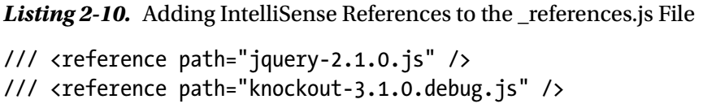
Listing 2-10

Slide 71
Defining the Client-Side Data Model and Controller
The basic model for creating single-page applications with jQuery and Knockout is to follow the same approach taken on the server side:
a data model that is manipulated by a controller, which selects the views to be displayed and responds to user input.
To get started, I added a JavaScript file called rsvp.js to the Scripts folder, the contents of which are shown in Listing 2-11.
The PartyInvites application is sufficiently simple that I have defined the data model and the functions that comprise the controller in the same JavaScript file.
For more complex projects (like the SportsStore application I created in Chapters 5–8), I use several files.
In the sections that follow, I describe the contents of the JavaScript file.

Slide 72
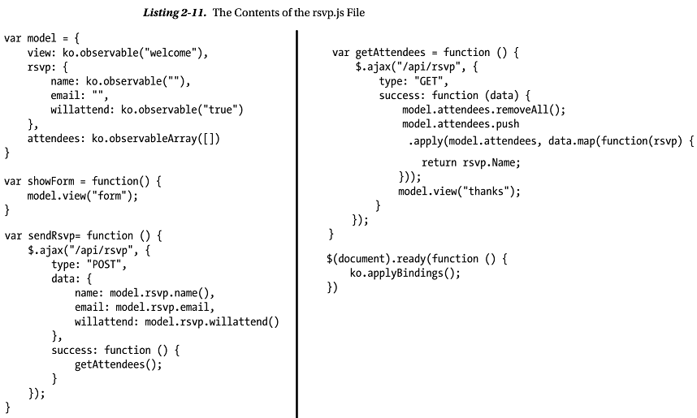
Listing 2-11

Slide 73
Defining the Model
The data model is at the heart of the client-side part of the application, just as it is in the server.
I have defined a JavaScript object called model that has properties that correspond to the data items I need in the application – Listing 2-11A.
There are two Knockout-specific features in the model object.
The first is the use of the ko.observable method, which is used to create a data value that can be used to automatically update HTML elements when it changes.
I use the view property, for example, to keep track of which client-side view should be displayed to the user, and I don’t have to write any additional code to change the view—I just set the value for the view property.
The hard work is done by a Knockout binding, which I apply to the HTML in the “Adding Data Bindings” section.
Data values that are created with the ko.observable method are known as observables.
The other Knockout feature is similar; the ko.observableArray method performs the same role as ko.observable but for an array of objects, creating what is known as an observable array.

Slide 74
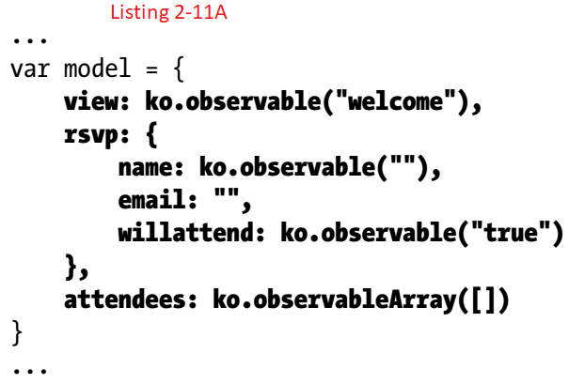
Listing 2-11A

Slide 75
Defining the Controller

Slide 76
Initializing Knockout

Slide 77
Registering the JavaScript File

Slide 78
Appling Data Bindings

Slide 79
Testing the Single-Page Client

Slide 80
Measuring the Single-Page Implementation

Slide 81
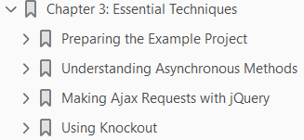
3
Essential Techniques

Slide 82
Intro
As I explained in Chapter 1, this book is targeted at MVC framework developers, which means you already know C# and key components such as Razor and action results.
In this chapter, I provide a quick primer for three topics that you may not be as familiar with:
using C# async methods
making Ajax requests using jQuery
using the Knockout library
Understanding all three will help you get the most from this book.
Asynchronous methods are important in Web API development, especially once you go beyond creating action methods and start to customize the way that requests are processed using the techniques I describe in Part 3 of this book.
jQuery and Knockout are not part of Web API, but I use them throughout this book to create client applications that demonstrate different kinds of interactions with web services that I create using Web API.
jQuery and Knockout are both packages with a rich range of functionality, but I describe only the features that I use in examples.

Slide 83
Preparing the Example Project
For this chapter, I created a new Visual Studio project by following the same process that I used in Chapter 2 and that I use throughout this book.
Select New Project from the File menu to open the New Project dialog window, and locate the ASP.NET Web Application template in the Visual C# ➤ Web section.
Set the name of the project to Primer, as shown in Figure 3-1.

Slide 84
Understanding Asynchronous Methods

Slide 85
Making Ajax Requests with jQuery

Slide 86
Using Knockout

Slide 87
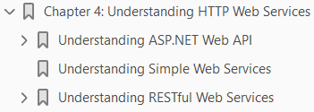
4
Understanding HTTP Web Services

Slide 88
Intro
In this chapter, I explain the different ways in which ASP.NET Web API can be used to deliver an HTTP web service and the kinds of clients that each arrangement best suits.
I build on this foundation to describe the two broad categories of web service that you can create:
simple web services (like the one I created in Chapter 2) and
RESTful web services, which are more complex but are easier to maintain
The choice between simple and RESTful web services echoes themes that run through MVC framework development:
an initial investment of design and development time
that is paid back through a loosely coupled system that is easier to change over time.
To explain RESTful web services, I describe the process for designing and evolving an API that allows a client to consume the service in a loosely coupled way.
The result is a description of a RESTful API that may strike you as rather abstract, but don’t worry because I back this up with implementation examples in Chapter 5–8, as well as detailed explanations of the ASP.NET Web API features throughout this book.

Slide 89
Understanding ASP.NET Web API
ASP.NET Web API solves a simple problem: it creates services that deliver data from ASP.NET applications to clients over HTTP requests, known as HTTP web services.
This may sound similar to the MVC framework, but the difference is that MVC usually delivers content that mixes the data with presentation instructions to the client.
Figure 4-1 shows the standard arrangement of components in an MVC framework application.
The MVC framework view combines Razor markup with model data to generate content that can be presented to the user, typically as a combination of HTML, CSS, and JavaScript.
ASP.NET Web API also uses a controller and a model, but it doesn’t have views.
Instead, it sends just the data, as illustrated in Figure 4-2.
Sending just the data means that presenting the data to the user becomes the responsibility of the client that made the HTTP request.
There are four different types of Web API client, each of which benefits from a data-only service in a different way:
single-page applications
native applications

Slide 90
Understanding ASP.NET Web API |
shared-model applications
service applications
I describe each of the client types in the sections that follow.
The decision about which model to use is driven largely by where raw data is processed and combined with presentation elements to show to the user.
The presentation need not be HTML
native clients use their own UI toolkits, and
service applications may not present the data to a user at all

Slide 91
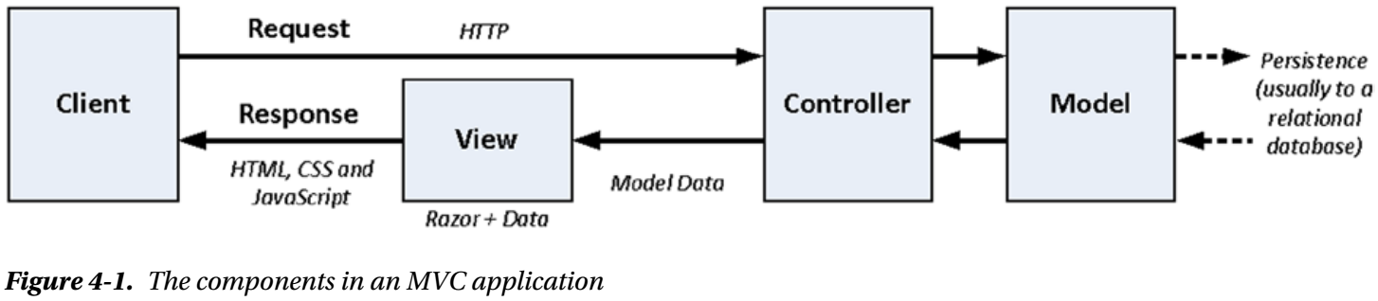
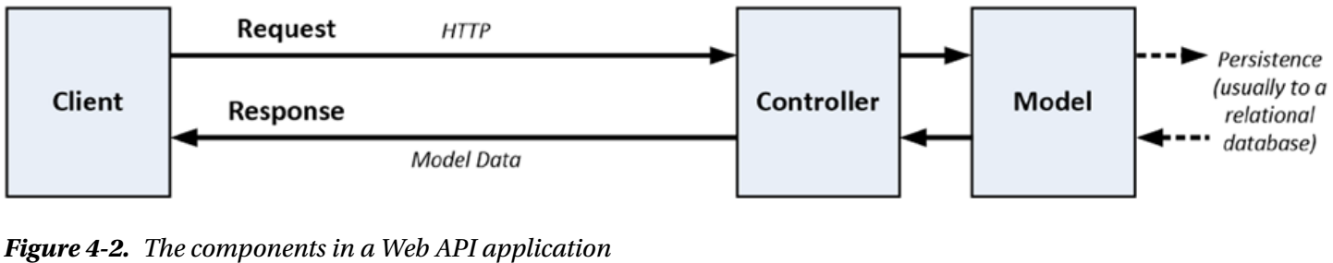
Figure 4-1 || 4-2

Slide 92
Understanding Single-Page Applications
Browser-based web applications can be broken into two broad categories.
The first is round-trip applications, which is where every request to the server returns a complete page of HTML content.
The other category, single-page applications, starts with an HTML document and uses JavaScript to make Ajax requests to the server for additional data or fragments of HTML in order to response to user interaction.
In Chapter 2, I created a simple single-page application to introduce you to ASP.NET Web API.
These round-trip and single-page categories are the ends of a spectrum, and most modern web applications fall somewhere in the middle such that some requests return complete HTML documents, while others are just for data.
For most MVC framework developers, single-page applications are the reason that ASP.NET Web API is interesting, allowing an HTTP web service to be used alongside the MVC framework components of an application, and it is this model that I focus on for most of the book.
The MVC framework is used to deliver the initial content, which is then supplemented or updated using Ajax requests to an ASP.NET Web API web service, as shown in Figure 4-3.

Slide 93
Understanding Single-Page Applications |
The model data is processed in two places:
in the view when the initial content for the application is requested from the MVC controller
in the browser when the data is received from the Web API controller
ASP.NET makes it easy to create a data model that is exposed to clients through MVC and Web API controllers, as I demonstrated in Chapter 2.

Slide 94
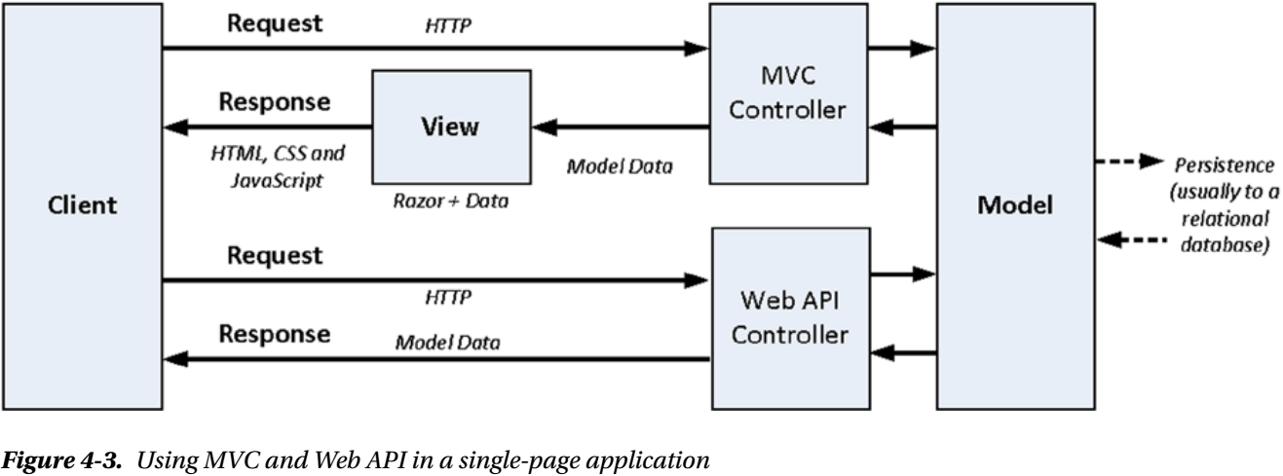
Figure 4-3

Slide 95
Understanding Native Applications
The rise of smartphones and tablets means that many applications are delivered as native clients, rather than as HTML content in a browser window.
Native applications still require data and perform operations on that data, which is readily supported through Web API.
Web API delivers the data, and the native applications are responsible for processing the data they receive and displaying it to the user.
Figure 4-4 shows a mix of client types being supported by an ASP.NET application.
Smartphones and tablets are not the only kinds of native application, and just about any application that can send HTTP requests and process common data formats can consume a web service.
Smartphones are the most numerous native clients, especially if you are creating an Internet-facing application, but you can also use Web API to support
desktop clients
embedded devices
smart TVs
I don’t describe native applications in this book, but the web services that I create with Web API can easily be consumed by any kind of client.

Slide 96
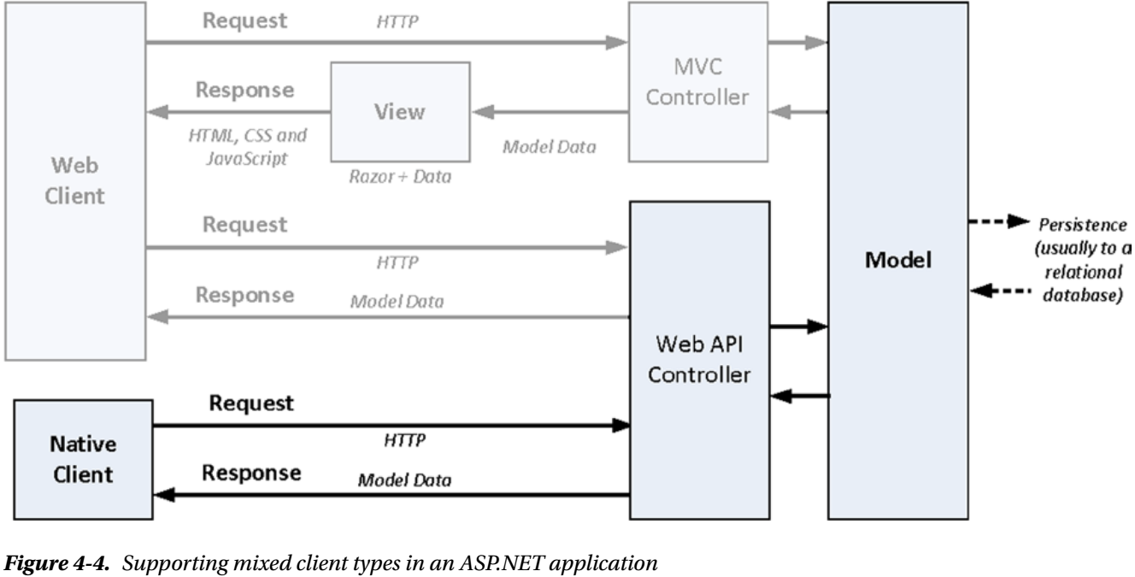
Figure 4-4

Slide 97
Understanding Shared-Model Applications
The implicit assumption in Figure 4-4 is that the model state is stored persistently and that all of the applications that need to access the model will do so through the data store, which is typically a database of some kind.
The problem with this approach is that databases are good at managing data but do not have means to consistently enforce features such as authorization or logging in a way that makes sense for the application.
For example, it may be possible to log a particular SQL query but not what application function the user was performing that led to the query.
In addition, if there are multiple applications that need to share the model data, it can be difficult to manage schema and data changes without upgrading the database and all of the applications in lock-step, which requires careful planning and testing.
An alternative approach is to use a web service to mediate access to the data store from multiple applications, providing an abstraction from the storage implementation and isolating the applications from changes in the way that data is stored.
Figure 4-5 shows this approach.
Using a web service as a model mediator can impact performance, but the benefits can be worth it if the way that the data is stored is particularly difficult to work with or is expected to change often.

Slide 98
Understanding Shared-Model Applications |
In this configuration, the MVC applications are treated just like any other client of the web service and combine the data and markup in the view.

Slide 99
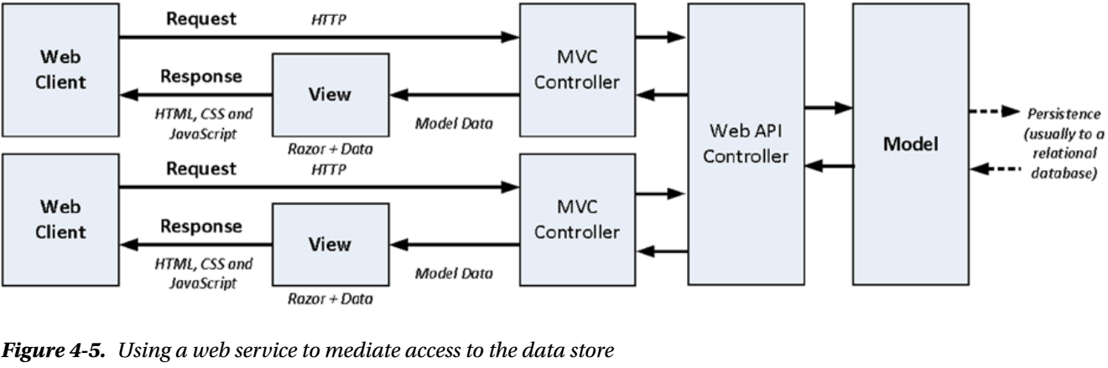
Figure 4-5

Slide 100
Understanding Service Applications
Service applications don’t interact directly with users.
Instead, they obtain data from a web service and package or process it for a different kind of client.
Service applications add some kind of value to the web service, perhaps by
combining data and operations from multiple web services into a single API
performing complex calculations
Supporting service clients can be a good way to make data available to a wider audience, which may go far beyond your existing user base.
From the perspective of the application, there is little difference between supporting a native application and a service application
the same HTTP requests are received and processed to retrieve data or update the model
the way in which the data is processed or presented is not known to the web service

Slide 101
TIP
You can see a good example at http://fitbit.com of an API that reaches a wider audience through service applications.
Fitbit sells hardware devices that monitor activity levels and provides a web application that collects the activity data.
The data and user information are exposed through an API, which has allowed a substantial ecosystem of other sites and services to thrive.
Supporting service clients can be useful if your business model isn’t tied to drawing users into your application.

Slide 102
Understanding Simple Web Services
The HTTP web service that I created with ASP.NET Web API in Chapter 2 is what is referred to as a simple web service or, to use a term that has more resonance for an MVC framework developer, a tightly coupled web service.
The tight coupling refers to the fact that the client has to have prior knowledge of how the web service has been designed in order to consume the web service.
As an example of prior knowledge, the client in the PartyInvites application needs to know that new RSVP responses are submitted as POST requests to the /api/rsvp/add URL.
There is nothing in the responses sent by the Web API controller to indicate that the /api/rsvp/add URL exists; the client needs to have this information ahead of time.
This isn’t hard to arrange when the client code is delivered from an MVC framework application because you can embed the information in a view, it becomes more of a problem for native clients of a web service, such as iPhone and Android applications.
As you may expect if you are familiar with the MVC pattern, the problem with tight coupling is that it makes it hard to maintain the application because changes have to be made to the Web API controller and the client JavaScript code at the same time.

Slide 103
Understanding Simple Web Services
It also makes it difficult to use the Web API controller beyond its original purpose because controllers for simple web services tend to offer only action methods for the specific functions that the original client requires.
As an example, if I needed to add an administration-type client that allows me to list, edit, and delete guest responses, then I need to extend the functionality of the controller—something that prevents clients from being created without the coordination of the web service developer.
The alternative is to create a web service that doesn’t require the client to have any prior knowledge of the web service, which is the essence of what REST is all about.
I describe REST and RESTful web services in the next section and demonstrate how ASP.NET Web API can be used to create them, but before I move on, I want to emphasize that you should not dismiss simple web services out of hand.
Despite the problems that arise from tight coupling, simple web services can transform a round-trip MVC framework application to the single-page model with just a few lines of C# and JavaScript code.
You saw this in Chapter 2, where I created the following Web API controller: Code 4-0.

Slide 104
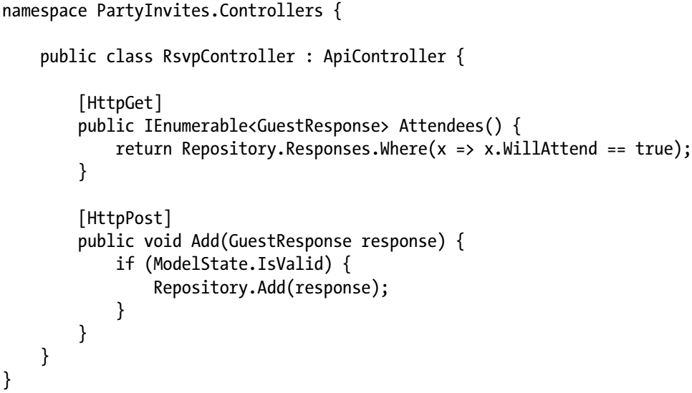
Code 4-0

Slide 105
Advantages
It is hard to beat the level of return for such little investment of effort.
Simple web services are perfectly acceptable for situations where you are confident that the only client will be delivered by the MVC framework and you know that the rate of change will be low and not driven by third parties (in other words, you are not trying to create an API that can be consumed by a wider audience outside the scope of the MVC framework application).
Table 4-1 summarizes simple web services and the situations in which they can be usefully applied.

Slide 106
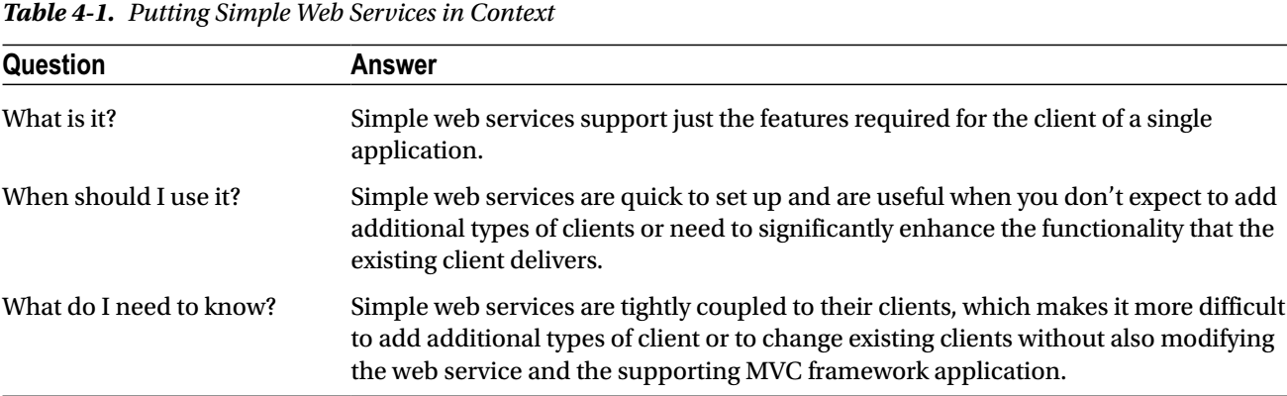
Table 4-1

Slide 107
Understanding RESTful Web Services
The most commonly used pattern to create loosely coupled web services is Representational State Transfer (REST).
REST is a general-purpose pattern that, when applied to a web service, creates what is known as a RESTful web service.
In the sections that follow, I describe how to design a RESTful web service API using the GuestResponse model class that I defined for the PartyInvites application in Chapter 2.
As a reminder, Listing 4-1 shows the definition of the model class.
As a reminder, here is how instances of the GuestResponse class are rendered as JSON: Code 4-2.
I am not going to implement the web service in this chapter; I will just define the API that I need.
You can see how I implement a RESTful web service in Chapter 6, where I build the more realistic SportsStore application to show the end-to-end implementation process for working with ASP.NET Web API.
The reason I don’t write the code in this chapter is that I want to focus on the design of an effective and useful web service API free of the details of its implementation.
Understanding why RESTful web services are useful is important, not least because they are more complex and complicated to design.

Slide 108
Understanding RESTful Web Services
As you will learn, decoupling the client from a web service requires more of an investment of time and effort, which is then paid back through increased flexibility and maintainability, much like the initial investment required to lay the foundation for an MVC framework application.
Table 4-2 summarizes RESTful web services and the situations in which they can be usefully applied.

Slide 109
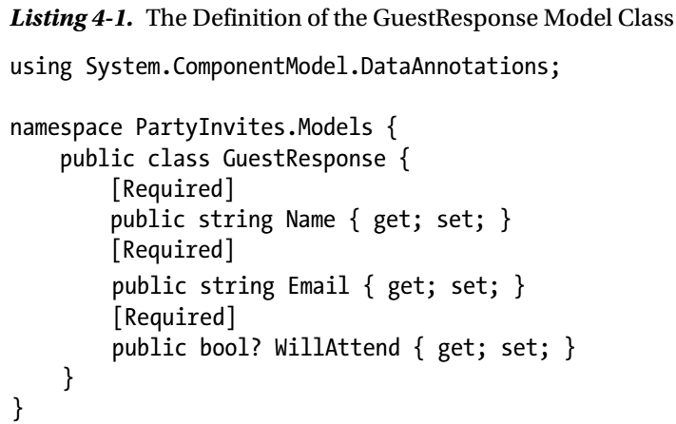
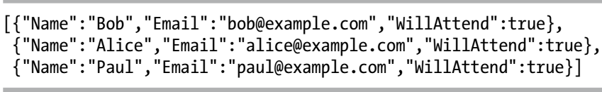
Listing 4-1 || Code 4-2

Slide 110
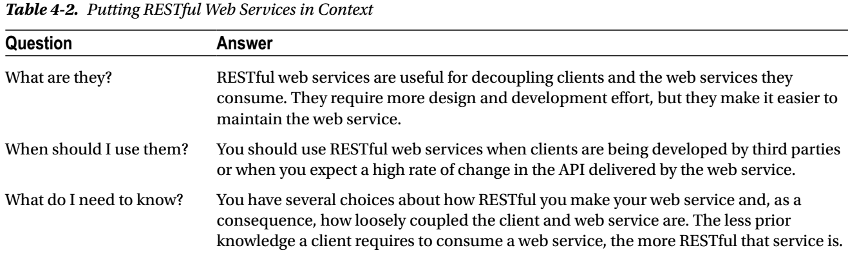
Table 4-2

Slide 111
THE DANGER OF DESIGN PATTERNS
Like just about all useful design patterns, REST is the subject of endless arguments about what is really RESTful and what is not.
These arguments are a waste of time, and you should ignore them.
Patterns are templates that you can customize for your own needs.
The goal behind RESTful web services is to ensure that the client and ASP. NET Web API controller are loosely coupled, and only you know which aspects of the REST pattern will help you achieve that goal.
I stopped arguing with pattern zealots when I realized that the least-skilled programmers are the ones who shout the loudest.
My advice is to focus on delivering good software and borrow from and adapt patterns any way you need to get the job done.

Slide 112
TIP
Although I use JSON throughout this chapter, ASP.NET Web API is capable of generating different data formats to suit different client requirements.
See Chapters 11–13 for details.

Slide 113
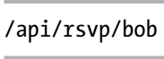
Embracing HTTP
The core foundation of RESTful web services is to define operations on the model using a combination of HTTP verbs and unique URLs to refer to individual data objects and collections of those objects.
Here is an example of a URL that uniquely represents the RSVP response from a user called Bob (I have left out the part of the URL that specifies the protocol, hostname, and port because all of these are going to be constant for my example):
In a RESTful web service, I use this URL whenever I want to perform an operation on the GuestResponse object that describes Bob’s attendance at the party.
To tell the web service what kind of operation I want to perform, I make an HTTP request that targets the URL and specify one of the HTTP verbs in the request.

Slide 114
TIP
The terms verbs and methods are equivalent when referring to HTTP and can be used interchangeably.
I tend to refer to methods when I am writing MVC framework views (because the form element defines a method attribute) and verbs when writing web services.
A web service doesn’t have to support all the verbs listed in Table 4-3.
It wouldn’t make sense for a read-only web service to support the DELETE, POST, and PUT verbs, for example, and you need to implement support only for the verbs you require.

Slide 115
NOTE
REST is a general-purpose pattern that has found a home in the world of web services, but since this is a book about web services, I am going to treat REST and RESTful web services as being the same thing so that I don’t get tied up in making fine-grained distinctions that don’t have any real impact on Web API development.

Slide 116
HTTP Verbs
You are already familiar with at least two of the HTTP verbs from their use in the MVC framework:
GET
POST
What you might not know is that the HTTP specification contains additional verbs and that, in a RESTful web service, these are used to indicate what kind of operation is being requested on the data object identities by the URL in the request.
Table 4-3 shows how combining an HTTP verb with a URL can be used to request that a web service perform an operation.
Some operations require the client to send data to the server or the server to send data to the client, and I have included this information in the table.
The contents of the table define the web service API, and a client-side developer can use this information to consume the web service.
This kind of API embraces HTTP by combining URLs and HTTP verbs, which feels exciting and dynamic and like a definite improvement over URLs derived from arbitrary methods names in a controller class, but the truth is somewhat different because the client and server are still too tightly coupled for comfort.
I explain why in the following sections.

Slide 117
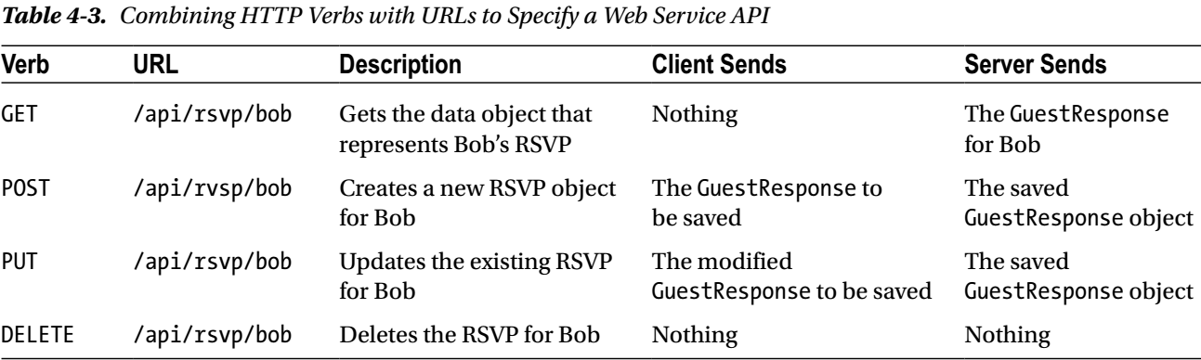
Table 4-3

Slide 118
USING SAFE & IDEMPOTENT HTTP VERBS
There is no standard mapping of HTTP verbs to web service operations, although the one I describe in Table 4-3 is common.
You can use any HTTP verb that you like for your web services, as long as you understand the importance of the safe and idempotent HTTP verbs.
Safe verbs have no side effects.
The most commonly used safe verb is GET, and when you receive a GET request, you may not perform any action that alters the state of the data model.
All you may do is return the data that has been requested and, optionally, perform cross-cutting activities such as logging and caching.
Idempotent verbs, such as PUT and DELETE, are allowed to modify the data model, but multiple requests with the same verb to the same URL should have the same effect as a single request.
The practical effect of this is that you should use URLs to uniquely identify resources, rather than relying on the relationship between data items.
For example, if you support a URL such as /api/rsvp/first that refers to the first data object in the repository, accepting a DELETE request for that URL should not cause the data items to shuffle so that there is a new “first” object.

Slide 119
USING SAFE & IDEMPOTENT HTTP VERBS |
You must also write your web service so that it doesn’t generate an error when receiving multiple requests such as a DELETE request for a data object that has already been removed from the repository.
Be careful with the POST verb; it is not necessarily safe or idempotent, and you have some flexibility about how you respond to multiple requests that target the same URL.
Most web services will treat a POST request as a PUT request if there is already a matching data item, but you can choose to create a new object or report an error depending on the needs of your data model.

Slide 120
Adding Data Discovery

Slide 121
Filtering the Collection

Slide 122
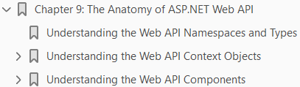
9
Anatomy of Web API

Slide 123
Intro
This chapter isn’t meant to be read right away.
Instead, it contains a number of tables that you can refer to as you read through the chapters that follow.
ASP.NET Web API uses a completely different set of namespaces and types than the ones you are familiar with in the MVC framework, and keeping track of which class or interface is responsible for a feature or behavior can be difficult, especially when you start working on your own Web API projects.

Slide 124
Understanding Web API Namespaces & Types
Web API and the MVC framework share a common heritage and a common design philosophy, but for every important interface and class that you are familiar with in MVC framework development, there is a completely separate counterpart used by Web API.
Table 9-1 provides a loose mapping for the ones that you will encounter most often.
The classes and interfaces are equivalent, but there isn’t a one-to-one mapping of methods and properties.
In part this is because Web API builds on the System.Net.Http namespace, which was introduced in .NET 4.5 and provides a set of classes that allow any .NET application to support HTTP by providing objects that describe HTTP in a neutral way.
Web API uses the types from the System.Net.Http namespace to represent requests and responses (the HttpRequestMessage and HttpResponseMessage classes), HTTP status codes (the HttpStatusCode enum), and HTTP verbs (the HttpMethod class).
Functionality that is specified to Web API is contained in the System.Web.Http namespace and its children, defined as regular interfaces and classes or defined as extension methods that operate on System.Net.Http classes.
Microsoft has avoided the System.Web and System.Web.Mvc namespaces for Web API as part of a gradual effort to rework the ASP.NET platform into something more flexible for web application development and one that can be enhanced independently of the main .NET Framework.

Slide 125
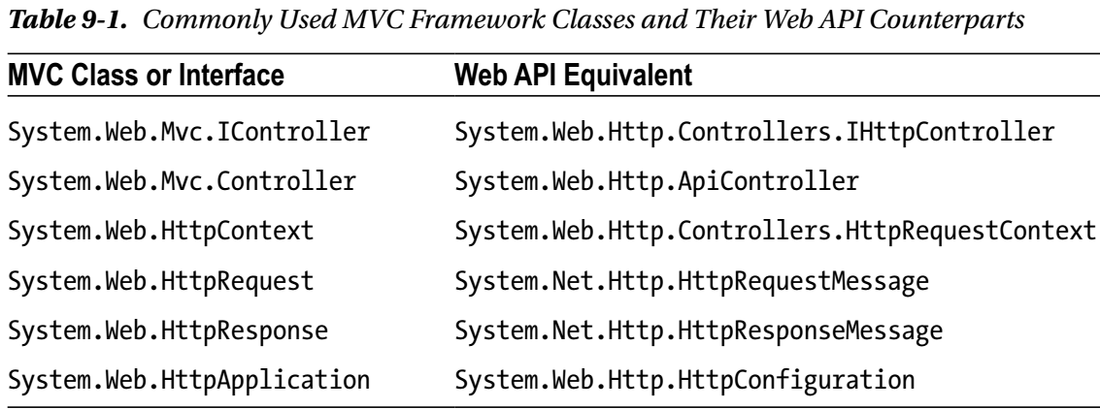
Table 9-1

Slide 126
New Approach
At the moment, Web Forms and MVC framework applications get a monolithic block of services through the System.Web assembly, which is shipped as part of the main .NET Framework.
The approach that the ASP.NET team is moving toward allows developers to select just the services they want and to have choices about which implementations are used.
You might, for example, decide to use Microsoft’s session state implementation, a third-party logging and tracing implementation, and not to use caching services at all.
The engine for this change is a standard called Open Web Interface for .NET (OWIN) that allows more flexibility in how Web API applications are hosted. I describe it in Chapter 26.
For the moment, it is enough to know that Web API doesn’t use the System.Web and System.Web.Mvc namespaces that you are familiar with and that even the most venerable ASP.NET classes, such as HttpRequest and HttpResponse, are not used when developing HTTP web services with Web API.

Slide 127
Namespaces
As a quick reference, Table 9-2 lists the main namespaces that you will use during Web API development and where in the book I describe them in detail.
As the table illustrates, there are a lot of Web API namespaces, but many of them contain just a few types, and basic Web API applications can be created with little effort, as I demonstrated in Chapter 2.
Even more complicated applications, such as the one I created in Chapters 5–8, can’t be created using a small number of classes.

Slide 128

Table 9-2

Slide 129

Table 9-2 |

Slide 130
WHY CAN’T I USE THE ASP.NET PLATFORM FEATURES ANYWAY?
It often feels like Microsoft makes changes just for the sake of it, and you may have a familiar sinking feeling as you look over the types and namespaces in Tables 9-1 and 9-2, contemplating another steep learning curve.
At this moment, most experienced ASP.NET developers realize that there is a shortcut: use the static HttpContext.Current property to get access to the familiar set of classes provided by the ASP.NET platform, which are still there behind the scenes as long as you are deploying your application to IIS.
Like most shortcuts, you gain in the near term only to pay a price in the long term. You can ignore the System.Net.Http classes, for example, and focus on the classes you know from the System.Web namespace, such as HttpRequest and HttpResponse.
And, at first, you will start to produce Web API HTTP web services more quickly and more easily, which is the near-term gain.
The long-term price is that you can’t access advanced Web API features using the old classes and you end up with even more tortured adaptor classes as your Web API needs become more complex.
In the end, you’ll spend more time trying to avoid the new Web API classes than it takes to learn how they work.
Having two separate sets of namespaces in an application is a little awkward, but my advice is to embrace the change and avoid long-term complexity and maintenance problems.

Slide 131
Understanding the Web API Context Objects
Web API provides a set of objects that provide context about the state of the application and the request that is being handled.
The main way you will encounter these objects is through properties defined by the ApiController class, from which Web API controller classes are derived.
I describe the role of the ApiController class in more detail in Chapter 22, but Table 9-3 describes the properties it defines that return context objects.

Slide 132

Table 9-3

Slide 133
Getting Information About the Request
Requests are represented by the HttpRequestMessage class, which is defined in the System.Net.Http namespace.
You are unlikely to need to use the HttpRequestMessage class directly as you start creating simple web services with Web API, but you will begin to use it a lot when you apply some of the more advanced features or begin to customize the way that Web API handles HTTP requests.
Table 9-4 describes the properties that the HttpRequestMessage class defines.
The HttpRequestMessage class provides a generalized view of an HTTP request, without any detail that is specific to web services.
Web API supplements the HttpRequestMessage class with the HttpRequestContext class, the most important properties of which I describe in Table 9-5.

Slide 134

Table 9-4

Slide 135

Table 9-5

Slide 136
Getting Information About the Controller
The HttpControllerContext class provides access to much of the same context data as the HttpRequestContext class but also describes the controller.
The similarity between the properties defined by context classes is a facet of the Web API dispatch process, which I describe in Part 3, which doesn’t make assumptions about the controller that will be selected to handle a request—a feature that allows custom controller implementations to be easily created, as I demonstrate in Chapter 22.
Some context classes, such as HttpRequestContext, are used more when writing individual web service, and others, such as HttpControllerContext, are more useful when you are customizing the request dispatch process.
Table 9-6 lists the properties defined by the HttpControllerContext class.

Slide 137

Table 9-6

Slide 138
Getting Information About Everything Else
The Web API namespaces contain other context objects that are of use only for specific—often advanced—tasks.
Rather than list all of their properties here, Table 9-7 describes the classes and references the chapter where I describe each of them in more detail.

Slide 139

Table 9-7

Slide 140

Table 9-7 |

Slide 141
Understanding the Web API Components
The basic approach that Web API follows to handle HTTP requests will be familiar from using the MVC framework, but there are a some important differences to be aware of.
In the sections that follow, I briefly describe the major components in a Web API application and explain how they are applied, along with references to the chapters in this book where you can find more information.
Application Configuration
Controllers, Actions and Results
Services
Dispatchers and Handlers

Slide 142
Application Configuration
Web API configuration is performed in the App_Start/WebApiConfig.cs file.
Add all configuration statements— including those for URL routing—to the Register method, including those that set up URL routes.
See Chapter 10 for details of configuring a Web API application and remember not to do any configuration in the Global Application Class (the Global.asax.cs file) because it isn’t supported for all Web API deployment options.

Slide 143
Controllers, Actions and Results
Web services are defined through controllers.
The most common way to create a controller is to derive a class from ApiController, which is defined in the System.Web.Http namespace.
The ApiController class provides a number of features that make it simple to create HTTP web services, including
action methods
action results
model binding and
validation
Although the ApiController class is the normal base for controllers, you can also implement your own approach to processing requests by implementing the IHttpController interface.

Slide 144
Services
ASP.NET Web API defines a set of interfaces and classes that are used to process requests, and these are known as services.
Examples include the interfaces that select controllers and action methods, perform model binding, and validate content.
The implementations of these interfaces define the infrastructure of a Web API application.
Services are either single-instance or multiple-instance.
For single-instance services, there is a single implementation of the service interface used across the entire application.
An example of a single-instance service interface is IHttpActionInvoker, which is responsible for invoking action methods in Web API controllers.
There is a default implementation of this interface included in Web API, and you can choose to replace it with a custom implementation, but only one of them will be used to invoke action methods.
For multiple-instance services, several implementations are available, presenting a choice about which one is used.
An example is the ModelBinderProvider class, which provides a model binder for a given type.

Slide 145
Services |
There are built-in derivations of the ModelBinderProvider class included in Web API, and you can define your own—and at runtime, the combined collection is available so that the most appropriate implementation can be selected and used.
Services are set up and accessed through the HttpConfiguration.Services property; this property returns an instance of the ServicesContainer class, which is defined in the System.Web.Http.Controllers namespace.
In addition to the methods described in Table 9-8, Web API provides a set of extension methods that provide strongly typed access to specific services.
I describe the most important of these extension methods in Table 9-9, along with details of the service interface they relate to and the chapter of this book where I explain the use of each of them.

Slide 146

Table 9-8

Slide 147

Table 9-9

Slide 148

Table 9-9 |

Slide 149
Dispatchers & Handlers
Web API has a well-defined model for processing requests.
There are lots of opportunities for customizing or extending this process, including adding message handlers and changing the way that controllers are selected, instantiated, and executed (all of which I describe in Chapter 19).
You can also customize the way that errors are handled (Chapter 25) and inject additional logic into the dispatch process through the use of filters (Chapters 23 and 24).

Slide 150

10
Creating & Configuring Web API Application

Slide 151

11
Action Method Results

Slide 152

12
Creating Media Type Formatters

Slide 153

13
Using Built-in Media Type Formatters

Slide 154

14
Understanding Parameter & Model Binding

Slide 155

15
Binding Simple Data Types

Slide 156

Binding Complex Data Types Part I

Slide 157

17
Binding Complex Data Types Part II

Slide 158

18
Model Validation

Slide 159

19
Dispatching Requests

Slide 160

20
URL Routing: Part I

Slide 161

21
URL Routing: Part II

Slide 162

22
Controllers & Actions

Slide 163

23
Filters part I

Slide 164

24
Filters part II

Slide 165

25
Error Handling

Slide 166

26
Using OWIN

Slide 167
ASP.NET Web API Release
ASP.NET Web API History
API
New Features in Web API
HTTP
Web Architecture
ASP.NET Web API Clients
Simple Web Services
RESTful Web Services
Dependency Injection
NuGet Packages Installation

Slide 168
ASP.NET Web API Release
What's new in recent Web API releases.
What's New in Web API OData 5.3
What's New in ASP.NET Web API 2.2
What's New in ASP.NET Web API 2.1

Slide 169
What's New in Web API OData 5.3
The runtime features are released as NuGet packages on the NuGet gallery. You can install or update to the released NuGet packages by using the NuGet Package Manager Console:
New Features in ASP.NET Web API OData 5.3
Support for $levels in $expand
Support for Open Entity Types
Support for dynamic collection properties in open types
Support for inheritance for complex types

Slide 170

What's New in ASP.NET Web API 2.2
You can install or update to the released NuGet packages by using the NuGet Package Manager Console
New Features in ASP.NET Web API 2.2
OData v4
Attribute Routing Improvements
Web API Client support for Windows Phone 8.1

Slide 171

What's New in ASP.NET Web API 2.1
You can install or update to the released NuGet packages by using the NuGet Package Manager Console
New Features in ASP.NET Web API 2.1
Global Error Handling
Attribute Routing Improvements
Help Page Improvements
IgnoreRoute Support
BSON Media-Type Formatter
Better Support for Async Filters
Query Parsing for the Client Fo

Slide 172

ASP.NET Web API History

Slide 173
API
An application program interface (API) is code that allows two software programs to communicate with each other.
The API defines the correct way for a developer to write a program that requests services from an operating system (OS) or other application.
APIs are implemented by function calls composed of verbs and nouns.
The required syntax is described in the documentation of the application being called.

Slide 174
Types Of APIs
APIs take three basic forms:
Local Web API Program API
Local APIs are the original form, from which the name came.
They offer OS or middleware services to application programs.
Microsoft's .NET APIs, the TAPI (Telephony API) for voice applications, and database access APIs are examples of the local API form.
Web APIs are designed to represent widely used resources like HTML pages and are accessed using a simple HTTP protocol.
Any web URL activates a web API. Web APIs are often called REST (representational state transfer) or RESTful because the publisher of REST interfaces doesn't save any data internally between requests.
As such, requests from many users can be intermingled as they would be on the internet.
Program APIs are based on remote procedure call (RPC) technology that makes a remote program component appear to be local to the rest of the software.
Service oriented architecture (SOA) APIs, such as Microsoft's WS-series of APIs, are program APIs.

Slide 175
New Features in Web API
Web API also adds some new concepts and features specific to HTTP service development:
HTTP programming model: The Web API development experience is optimized for working with HTTP requests and responses.
There’s a strongly typed HTTP object model, HTTP status codes and headers are easily accessible, and so on.
Action dispatching based on HTTP verbs: In MVC the dispatching of action methods is based on their names.
In Web API, methods can be automatically dispatched based on the HTTP verb.
Ex: A GET request would be automatically dispatched to a controller action named GetItem.
Content negotiation: HTTP has long supported a system of content negotiation, in which browsers (and other HTTP clients) indicate their response format preferences, and the server responds with the highest preferred format that it can support.
This means that your controller can supply XML, JSON, and other formats (you can add your own), responding to whichever the client most prefers.
This allows you to add support for new formats without having to change any of your controller code.

Slide 176
New Features in Web API |
Code-based configuration: Service configuration can be complex.
Unlike WCF’s verbose and complex configuration file approach, Web API is configured entirely via code.

Slide 177
HTTP
HTTP is not just for serving up web pages.
HTTP is also a powerful platform for building APIs that expose services and data.
HTTP is simple, flexible, and ubiquitous.
Almost any platform that you can think of has an HTTP library, so HTTP services can reach a broad range of clients, including browsers, mobile devices, and traditional desktop applications.
ASP.NET Web API is a framework for building web APIs on top of the .NET Framework.

Slide 178
Web Architecture
The Web is built around three core concepts:
Resources
URIs and
Representations
Media Type (Closely Related)
as shown in Figure 1-2.
A resource has a URI that identifies it and that HTTP clients will use to find it.
A representation is data that is returned from that resource.
Also related and significant is the media type, which defines the format of that data.

Slide 179

Web Architecture

Slide 180
Resource
A resource is anything that has a URI.
The resource itself is a conceptual mapping to one or more entities.
In the early years of the Web it was very common for this entity to be a file such as a document or web page.
However, a resource is not limited to being file oriented. A resource can be a service that interfaces with anything such as
a catalog
a device (e.g., a printer)
a wireless garage door opener or
an internal system like a CRM or
a procurement system
A resource can also be a streaming medium such as
a video or
an audio stream.

Slide 181
URI
Each resource is addressable through a unique URI.
You can think of a URI as a primary key for a resource.
Examples of URIs are
http://fabri‐ kam.com/orders/100 http://ftp.fabrikam.com,
mailto:John.Doe@example.com telnet:// 192.168.1.100
urn:isbn:978-1-449-33771-1.
A URI can correspond only to a single resource, though multiple URIs can point to the same resource.
Each URI is of the form: scheme:hierarchical part[?query][#fragment]
with the query string and fragment being optional.
The hierachical part further consists of an optional authority and hierachical path.

Slide 182
URI: Categories
URIs are divided into two categories, URLs and URNs.
A URL (Universal Resource Locator) is an identifier that also refers to the means of accessing the resource,
A URN (Universal Resource Name) is simply a unique identifier for a resource.
Each of the preceding example URIs is also a URL except the last one, which is a URN for this book.
It contains no information on how to access the resource but does identify it.
In practice, however, the majority of URIs you will likely see will be URLs, and for this reason the two are often used synonymously.

Slide 183
Cool URIs
A cool URI is a URI that is simple, easy to remember (like http://www.example.com/ people/alice), and doesn’t change.
The reason for the URI not to change is so it does not break existing systems that have linked to the URI.
So, if your resources are designed with the idea that clients maintain bookmarks to them, you should consider using a cool URI.
Cool URIs work really well in particular for web pages to which other sites commonly link, or that users often store in their browser favorites.
It is not required that URIs be cool.
There are benefits to designing APIs without exposing many cool URIs.

Slide 184
Representation
A representation is a snapshot of a resource’s state at a point in time.
Whenever an HTTP client requests a resource, it is the representation that is returned, not the resource itself.
From one request to the next, the resource state can change dramatically, thus the representation that is returned can be very different.
For example, imagine an API for developer articles that exposes the top article via the URI http://devarticles.com/articles/ top.
Instead of returning a link to the content, the API returns a redirect to the actual article.
Over time, as the top article changes, the representation (via the redirect) changes accordingly.
The resource, however, is not the article in this case; it’s the logic running on the server that retrieves the top article from the database and returns the redirect.
It is important to note that each resource can have one or more representations.

Slide 185
Media Type
Each representation has a specific format known as a media type.
A media type is a format for passing information across the Internet between clients and servers.
It is indicated with a two-part identifier like text/html.
Media types serve different purposes.
Some are extremely general purpose, like application/json (which is a collection of values or key values) or text/html (which is primarily for documents rendered in a browser).
Other media types have more constrained semantics like application/ atom+xml and application/collection+json, which are designed specifically for managing feeds and lists.
Then there is image/png, which is for PNG images.
Media types can also be highly domain specific, like text/vcard, which is used for electronically sharing business card and contact information.

Slide 186
Media Type: Parts
The media type itself actually comprises two parts.
The first part (before the slash) is the top-level media type. It describes general type information and common handling rules.
Common top-level types are application, image, text, video, and multipart.
The second part is the subtype, which describes a very specific data format.
For example, in image/png and image/gif, the top-level type tells a client this is an image, while the subtypes png and gif specify what type of image it is and how it should be handled.
It is also common for the subtype to have different variants that share common semantics but are different formats.
As an example, HAL (Hypertext Application Language) has JSON (application/hal+json) and XML (application/hal+xml) variants. hal +json means it’s HAL using a JSON wire format, while hal+xml means the XML wire format.

Slide 187
ASP.NET Web API Clients
There are four different types of Web API client, each of which benefits from a data-only service in a different way:
Single-page applications
Native applications
Shared-model applications and
Service applications.

Slide 188
Simple Web Services
A simple web service or, to use a term that has more resonance for an MVC framework developer, a tightly coupled web service.
The tight coupling refers to the fact that the client has to have prior knowledge of how the web service has been designed in order to consume the web service.
As an example of prior knowledge, the client in the PartyInvites application needs to know that new RSVP responses are submitted as POST requests to the /api/rsvp/add URL.
There is nothing in the responses sent by the Web API controller to indicate that the /api/rsvp/add URL exists; the client needs to have this information ahead of time.
This isn’t hard to arrange when the client code is delivered from an MVC framework application because you can embed the information in a view, it becomes more of a problem for native clients of a web service, such as iPhone and Android applications.

Slide 189
Simple Web Services: Disadvantages
As you may expect if you are familiar with the MVC pattern, the problem with tight coupling is that it makes it hard to maintain the application because changes have to be made to the Web API controller and the client JavaScript code at the same time.
It also makes it difficult to use the Web API controller beyond its original purpose because controllers for simple web services tend to offer only action methods for the specific functions that the original client requires.
As an example, if I needed to add an administration-type client that allows me to list, edit, and delete guest responses, then I need to extend the functionality of the controller—something that prevents clients from being created without the coordination of the web service developer.
The alternative is to create a web service that doesn’t require the client to have any prior knowledge of the web service, which is the essence of what REST is all about.
Despite the problems that arise from tight coupling, simple web services can transform a round-trip MVC framework application to the single-page model with just a few lines of C# and JavaScript code.
Simple web services are perfectly acceptable for situations where you are confident that the only client will be delivered by the MVC framework and you know that the rate of change will be low and not driven by third parties.

Slide 190
RESTful Web Services
The most commonly used pattern to create loosely coupled web services is Representational State Transfer (REST).
REST is a general-purpose pattern that, when applied to a web service, creates what is known as a RESTful web service.
The goal behind RESTful web services is to ensure that the client and ASP. NET Web API controller are loosely coupled, and only you know which aspects of the REST pattern will help you achieve that goal.
RESTful web services are useful for decoupling clients and the web services they consume. They require more design and development effort, but they make it easier to maintain the web service.
You should use RESTful web services when clients are being developed by third parties or when you expect a high rate of change in the API delivered by the web service.
You have several choices about how RESTful you make your web service and, as a consequence, how loosely coupled the client and web service are.
The less prior knowledge a client requires to consume a web service, the more RESTful that service is.

Slide 191
RESTful services: Foundation
The core foundation of RESTful web services is to define operations on the model using a combination of HTTP verbs and unique URLs to refer to individual data objects and collections of those objects.
The terms verbs and methods are equivalent when referring to HTTP and can be used interchangeably.
Consider the URL /api/rsvp/bob
In a RESTful web service, I use this URL whenever I want to perform an operation on the GuestResponse object that describes Bob’s attendance at the party.
To tell the web service what kind of operation I want to perform, I make an HTTP request that targets the URL and specify one of the HTTP verbs in the request.
In a RESTful web service, the HTTP verbs are used to indicate what kind of operation is being requested on the data object identities by the URL in the request.
Some operations require the client to send data to the server or the server to send data to the client.
A web service doesn’t have to support all the verbs listed in Table 4-3.
It wouldn’t make sense for a read-only web service to support the DELETE, POST, and PUT verbs, for example, and you need to implement support only for the verbs you require.

Slide 192

HTTP Verbs
The contents of the table define the web service API, and a client-side developer can use this information to consume the web service.
This kind of API embraces HTTP by combining URLs and HTTP verbs, which feels exciting and dynamic and like a definite improvement over URLs derived from arbitrary methods names in a controller class, but the truth is somewhat different because the client and server are still too tightly coupled for comfort.

Slide 193
Safe & Idempotent HTTP Verbs
There is no standard mapping of HTTP verbs to web service operations.
You can use any HTTP verb that you like for your web services, as long as you understand the importance of the safe and idempotent HTTP verbs.
Safe verbs have no side effects. The most commonly used safe verb is GET, and when you receive a GET request, you may not perform any action that alters the state of the data model.
All you may do is return the data that has been requested and, optionally, perform cross-cutting activities such as logging and caching.
Idempotent verbs, such as PUT and DELETE, are allowed to modify the data model, but multiple requests with the same verb to the same URL should have the same effect as a single request.
The practical effect of this is that you should use URLs to uniquely identify resources, rather than relying on the relationship between data items.
For example, if you support a URL such as /api/rsvp/first that refers to the first data object in the repository, accepting a DELETE request for that URL should not cause the data items to shuffle so that there is a new “first” object.

Slide 194
Safe & Idempotent HTTP Verbs |
You must also write your web service so that it doesn’t generate an error when receiving multiple requests such as a DELETE request for a data object that has already been removed from the repository.
Be careful with the POST verb; it is not necessarily safe or idempotent, and you have some flexibility about how you respond to multiple requests that target the same URL.
Most web services will treat a POST request as a PUT request if there is already a matching data item, but you can choose to create a new object or report an error depending on the needs of your data model.

Slide 195
Data Discovery
Uniquely identifying each data object—more properly known as a resource in REST—with a URL is an excellent idea, but it presents a problem: how does the client discover the set of data objects and the URLs that refer to them?
The solution is to create a collection URL, which returns all of the data objects in the model.
The convention is that the collection of data objects is retrieved using the root URL that identifies individual objects.
In my API, this means that the URL /api/rsvp would return all of the data objects in the model.
Table 4-4 shows the addition of the collection URL to the web service API.

Slide 196

Table 4-4

Slide 197
Filtering the Collection
Most clients don’t need to retrieve all of the data in the model, so the convention is to allow clients to narrow the data returned by the collection URL by using query string parameters.
For example, to obtain the set of attendees, the client would send a GET request to the following URL:
/api/rsvp?WillAttend=true
The web service can ignore the query string and return all of the data objects in the model, but it is generally a good idea to support this convention so that you are not transferring endless amounts of data that clients don’t require and that will be discarded.
Table 4-5 shows my revised API.
A common variation on this pattern is to build the filter into the URL, rather than relying on the query string.
For example, consider a model objects when the URL /api/products is requested.
The object that has the unique identifier 100, for example, would be accessed via the URL /api/products/100.
Web API makes it easy to support both URL formats.

Slide 198

Table 4-5

Slide 199
Dependency Injection
Dependency injection (DI) breaks the direct dependency between classes.
A dependency injection container is configured with mappings between interfaces and implementation classes and is used by Web API to create instances of the classes it requires to handle HTTP requests.
The DI container inspects the classes it has been asked to create and resolves dependencies on the interfaces it has been configured with by creating and injecting the implementation classes.
In this way, I can arrange my application so that my controllers depend on the IRepository interface without any direct knowledge of which implementation class they receive in their constructor.
DI allows me to change the implementation that I use or to create mock implementations for unit testing without having to make any changes to the controller class.
Although DI plays the same role for Web API as it does in the MVC framework, the approach required is different and a slight improvement, but there are some issues to be aware of, especially when it comes to creating instances of objects for each HTTP request.

Slide 200
DI: Advantages
Dependency injection allows interfaces to be used without direct knowledge of the classes that implement them, creating loosely coupled components.
You should use dependency injection in any project that you need to unit test or where you expect to make changes following deployment.
Web API defines two interfaces to support DI but there are some obstacles to implementing per-request object scopes in Web API applications without relying on the ASP.NET platform.

Slide 201
Web API Dependency Interfaces
Dependency injection in Web API is handled by the IDependencyResolver and IDependencyScope interfaces, which are defined in the System.Web.Http.Dependencies namespace.
Listing 10-13 shows the definition of the IDependencyResolver interface.
This IDependencyScope interface defines GetService and GetServices methods, which perform the same role as in the equivalents in the MVC framework.
The GetService method is called when the Web API infrastructure needs a concrete type (such as a controller) or needs to use an interface for which there should be only one implementation (such as the IHttpActionInvoker interface).
The GetServices method is used when the Web API infrastructure expects there to be multiple implementations of an interface, all of which are required (such as IFilter).

Slide 202


Web API Dependency

Slide 203
Web API DI
The inheritance relationship between the interfaces can be confusing, but it starts to make sense when you understand that the Web API developers were trying to make it easier to deal with the two most common dependency injection scenarios in a web application:
creating objects that are used for the life of the application and
creating objects that are used for a single request
When the application starts, a single instance of the IDependencyResolver implementation object is created and kept by Web API for the life of the application, and its GetService and GetServices methods are used whenever an object is required for the Web API infrastructure.
In practice, this means it is used to create a lot of objects when the application is started (filters, data formatters, and so on) and then not used again.
There is only ever one instance of the class that implements the IDependencyResolver interface.
When Web API needs an object that will be used for a single request, such as a controller or a database context class, then it calls the BeginScope method of the IDependencyResolver object in order to get an implementation of the IDependencyScope interface and uses the GetService and GetServices methods to create the instances it needs.
When the request has been handled and the objects that have been created are no longer required, Web API

Slide 204
Web API DI |
calls the Dispose method on the IDependencyScope object (because it implements IDisposable) so that the objects that have been created can be prepared for destruction.
Most DI containers support scopes, which are used to decide when to create a new instance of a class and when to reuse an existing instance.
Building the per-request scopes into the dependency interfaces makes it easier to integrate DI containers into the Web API request handling process.
Most DI containers rely on the System.Web.HttpContext class to support per-request object life cycles, which can be a problem with Web API because you cannot rely on the System.Web classes.
It will be a while before the mainstream dependency injection containers catch up to the new Web API design, and until then, it can be slightly awkward to align container scopes to Web API scopes.

Slide 205
DI Container
Many dependency injection containers are available, and it is worth looking at a few before making a decision.
Popular choices include StructureMap, Castle Windsor, and Unity, which comes from Microsoft.
The DI container Ninject provides simple and fluent API.
Ninject, like all of the major DI containers, is available as a NuGet package.
Ninject makes it easy to support the two Web API resolution interfaces, and although it may seem odd, the easiest way to do so is by creating a single class.

Slide 206
NuGet Packages Installation
Consider the following list of packages to be installed in an Empty > MVC, Web API project.
Update-Package Microsoft.Aspnet.Mvc -version 5.1.1 - Issue Found
Update-Package Microsoft.Aspnet.Webapi -version 5.1.1 - No Issue
Update-Package Newtonsoft.Json -version 6.0.1 - No Issue
Install-Package Microsoft.AspNet.Identity.EntityFramework –Version 2.0.0 - No Issue
Install-Package Microsoft.AspNet.Identity.OWIN -Version 2.0.0 - No Issue
Install-Package Microsoft.Owin.Host.SystemWeb -Version 2.1.0 - Issue Found
Install-Package Microsoft.AspNet.WebApi.Owin -Version 5.1.1 - No Issue
Install-Package jquery -version 2.1.0 - No Issue
Install-Package bootstrap -version 3.1.1 - No Issue
Install-Package knockoutjs –version 3.1.0 - No Issue
Install-Package jquery.Validation –version 1.11.1 - No Issue

Slide 207
NuGet Packages Installation |
Install-Package Microsoft.jQuery.Unobtrusive.Validation –version 3.0.0 - No Issue
The above versions of the packages throw runtime exceptions when targeting .NET 4.5.1 and are documented in this section.

Slide 208

Microsoft.Aspnet.Mvc
As on 14 Apr 2018, when I create an Empty > MVC, Web API project, the version of MVC available is 5.2.4.
When I try to downgrade the version to 5.1.1, the reference in /Views/web.config file points to 5.2.3.0 which leads to an exception during runtime – Figure Nu-1.
To resolve this issue, open /Web.config file in the root directory and navigate to the node shown below:
From the above figure, we can infer that System.Web.Mvc package points to 5.1.0.0.
Now, head on to /Views/web.config file and change the references accordingly.

Slide 209

Figure Nu-1

Slide 210
Microsoft.Owin.Host.SystemWeb
I installed the package Microsoft.Owin.Host.SystemWeb as shown below:
After compiling the Web app, ASP.NET threw the runtime error as shown in Figure Nu-2.
The ASP.NET Identity packages look for a configuration class when the application starts.
Listing Nu-1 shows the content of the IdentityConfig.cs file, which I added to the App_Start folder.
Issue Resolved

Slide 211

Figure Nu-2

Slide 212

Listing Nu-1

